Slide 1
"Data is the hardest coupling — own a store, not a shared schema."
SUPPLEMENTARY · MODULE 4
Microservices Data
and Persistence
Give each service a persistence story: JPA and transactions, database-per-service, saga and outbox patterns, and the banking constraints around consistency and audit.
💾
🗃️
🔄
🏦
SPRING BOOT MICROSERVICES BOOTCAMP • DAY 2 • MODULE 4
Notes:
KEY TALKING POINTS
------------------
- Why data is the hard part
In a monolith, one database transaction can update accounts, transactions, and audit rows together.
Once each service owns its data, that convenience disappears.
Cross-service joins, reporting, and all-or-nothing updates all need deliberate design.
Frame the module as learning which guarantees stay local and which become workflows.
For example, a local transaction inside Transaction Service stays local.
Events and sagas between services become workflows.
- How the module maps to Lab 2
Everything here shows up in the lab.
Database-per-service becomes transaction_db, separate from account_db.
Spring Data JPA and Flyway become the Transaction entity and its repository.
They also become V1__create_transactions.sql, with ddl-auto set to validate.
Local transactions become the @Transactional create method.
Saga, outbox, and eventual consistency are taught as concepts.
The outbox is a prebuilt demo only.
Participants do not build it today.
- Checkpoint at the end
The module closes with Exercise 2.1, Map Data Ownership for Account vs Transaction.
Participants produce a two-column ownership map with zero shared tables.
Accounts live only in account_db.
Transactions live only in transaction_db.
accountId is stored as a plain reference, not a cross-service foreign key.
Eligibility is checked with a REST GET, not a SQL join.
Mention it now so participants listen with that map in mind.
REAL-WORLD EXAMPLES
-------------------
- Many banks run core account ledgers, card platforms, and fraud engines as separate systems.
Different teams own them.
The systems integrate through interfaces and messages.
One team does not write directly into another team's tables.
This module applies that same ownership discipline at microservice scale.
USE-CASE SCENARIO
-----------------
Set up the module with a question.
The Transaction Service needs to know whether an account is ACTIVE.
The fastest-looking option is to connect to account_db and run a SELECT.
Ask what happens next sprint, when the Account team renames the status column or adds a new status value.
The rest of the module explains the capstone's choice instead.
It calls the Account Service API and keeps each database private.

Slide 2
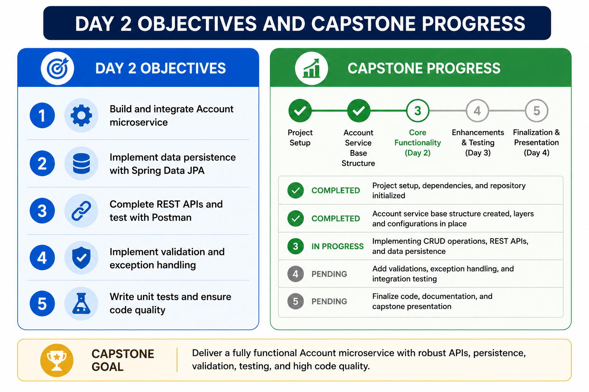
1
© 2026 by Innovation In Software Corporation
Notes:
KEY TALKING POINTS
------------------
- Day 2 Objectives column
The image lists building the Account microservice, persistence with Spring Data JPA, and REST APIs tested with Postman.
It also lists validation and exception handling, and unit tests.
Only the JPA item matches today.
State the real Day 2 objectives instead.
First, database-per-service and Spring Data JPA.
Second, Flyway migrations and local transactions.
Third, eventual consistency, with saga and outbox as concepts.
Fourth, synchronous REST versus asynchronous messaging.
Fifth, Kafka on Red Hat AMQ Streams, with produce, consume, correlation IDs, idempotency, and dead-letter handling.
- Capstone Progress tracker
The tracker shows five stages, with Day 2 as Core Functionality and Finalization on Day 4.
That does not match this five-day course.
Give the correct sequence.
Day 1 Account Service is done.
Day 2 adds Transaction Service with REST validation and Kafka events.
Day 3 adds JWT security, Resilience4j, and tests.
Day 4 adds observability, containers, OpenShift, and CI/CD.
Day 5 adds the Risk Assessment Service with OpenShift AI and the capstone demonstration.
- Capstone Goal banner
The banner says the goal is a fully functional Account microservice.
For today, restate it as a two-service workflow.
That is Account Service plus Transaction Service, each with its own PostgreSQL database.
A REST eligibility check and TransactionSubmitted events connect them.
Also note that the labs use curl.exe from PowerShell and Swagger UI to exercise APIs, not Postman.
That way participants do not look for a Postman collection.
REAL-WORLD EXAMPLES
-------------------
- Incremental delivery is how banks usually modernise.
One well-bounded capability goes live first.
Then the next capability integrates with it through an API.
The capstone mirrors that, with Account Service first and Transaction Service consuming it today.
- Program dashboards in large IT organisations often drift out of date as scope changes.
Checking status against the current plan before a steering meeting is standard practice.
That is what you are doing with this slide.
USE-CASE SCENARIO
-----------------
Tell participants to picture a sprint review for the risk platform.
Last sprint, the team demoed account creation and freeze.
This sprint, the product owner wants to see a debit submitted against an ACTIVE account and rejected against a FROZEN one.
They also want to see an event on Kafka.
Next sprint, security wants JWT on both services.
That sequence is exactly Days 1, 2, and 3 of this course.
Keeping it clear stops people trying to finish everything at once.

Slide 3
DATA OWNERSHIP IN MICROSERVICES · DATABASE PER SERVICE PATTERN
📌
BANKING OWNERSHIP EXAMPLE
✅
WHY OWNERSHIP MATTERS
• Account Service -> account records, status, nickname, customerId field
• Account Service -> account records, account status
• Transaction Service -> transaction ledger entries
• Risk Assessment Service -> risk scores, policy disposition, audit fields
• Supports independent schema evolution and deployment
• Other services access data through REST APIs, events, or read models -- never direct queries
❌
BAD DESIGN: SHARED DATABASE
✅
BETTER DESIGN: DATABASE PER SERVICE
• Account Service, Transaction Service, Risk Assessment Service -> shared_bank_db
• Services look separate in code but are tightly coupled through data
• Account Service -> account_db, Transaction Service -> transaction_db, Risk Assessment Service -> risk_db
• Services communicate through APIs and events rather than shared tables
KEY TAKEAWAY Account Service owns accounts, Transaction Service owns transactions, Risk Assessment owns scores -- no service reaches into another's tables. • Each service gets its own database or schema -- shared tables would silently recreate the coupling microservices exist to remove.
2
© 2026 by Innovation In Software Corporation
Notes:
TOPIC 1 OF 2: Data Ownership in Microservices
------------------------------------------
KEY TALKING POINTS
------------------
- BANKING OWNERSHIP EXAMPLE
Map the three capstone services.
Account Service owns account records, status, nickname, and a customerId field.
It stores only the synthetic customer ID, such as CUST-0001, not a customer profile.
Transaction Service owns transaction ledger entries in transaction_db.
Risk Assessment Service is built on Day 5 with its own risk_db.
It owns risk scores, the policy disposition, and audit fields.
Note that Account Service is listed twice on the slide.
Both lines describe the same ownership.
- WHY OWNERSHIP MATTERS
When one service owns a table, its team can change it freely.
They can add a column, add an index, or change a status value.
Then they deploy without negotiating a release date with other teams.
Other services use the owner's REST API, subscribe to its events, or keep their own read model.
A read model is a local copy shaped for their own queries.
In Lab 2, Transaction Service learns account status with a REST GET to Account Service.
It stores only the account_id it received.
It never joins to the accounts table.
REAL-WORLD EXAMPLES
-------------------
- A card authorisation platform typically asks the account system whether an account can be debited.
It does not read the ledger database directly.
The account system keeps control of its own rules, such as blocks, holds, and frozen status.
Every consumer gets the same answer.
- In many banks, a statement generation job queries operational tables directly.
That job then becomes the reason a schema change is postponed.
Feeding statements from events or a reporting extract removes that hidden dependency.
USE-CASE SCENARIO
-----------------
In the capstone, a compliance analyst asks why a debit was rejected.
Because ownership is clear, the answer is traceable.
Transaction Service logged that Account Service returned FROZEN for that accountId.
Account Service owns the record of when the freeze happened.
On Day 5, the Risk Assessment Service owns any score and disposition.
Each question goes to exactly one owner.
It does not go to a shared database that nobody fully controls.
TOPIC 2 OF 2: Database per Service Pattern
------------------------------------------
KEY TALKING POINTS
------------------
- BAD DESIGN: SHARED DATABASE
With shared_bank_db, the services look separate in the code base.
Each has its own repository and deployment.
But they are coupled through tables.
A column rename for Account Service can break a query in Transaction Service at runtime.
Nobody finds out until production.
Releases must be coordinated.
A heavy query from one service causes performance problems for everyone.
It is also unclear who approves a schema change.
- BETTER DESIGN: DATABASE PER SERVICE
Each service gets its own database or schema.
The lab makes this physical.
account_db uses host port 5433, transaction_db uses 5434, and on Day 5 risk_db uses 5435.
Services communicate through REST APIs and events, not shared tables.
The trade-off is real.
There are no cross-service joins and no single transaction across services.
That is why the rest of the module covers sagas, outbox, and eventual consistency.
REAL-WORLD EXAMPLES
-------------------
- Amazon has publicly described moving away from shared databases.
Its teams expose functionality only through service interfaces, so each team can change its internals independently.
The banking equivalent is an account platform team that publishes an API and events.
It does not grant other teams table access.
- A frequent enterprise failure mode is a reporting user or integration account with write access to an operational schema.
Separate databases with per-service credentials make that accidental coupling much harder to create.
USE-CASE SCENARIO
-----------------
Imagine the Account team adds a RESTRICTED status for accounts under legal hold.
With a shared database, Transaction Service code that checks for status equals ACTIVE keeps working.
But a reporting query that counts non-closed accounts silently changes meaning.
With database-per-service, Account Service publishes the new status through its API contract.
Transaction Service still receives a non-ACTIVE status and returns 409, and the change is reviewed as an API change.
It is not discovered later as a data surprise.

Slide 4
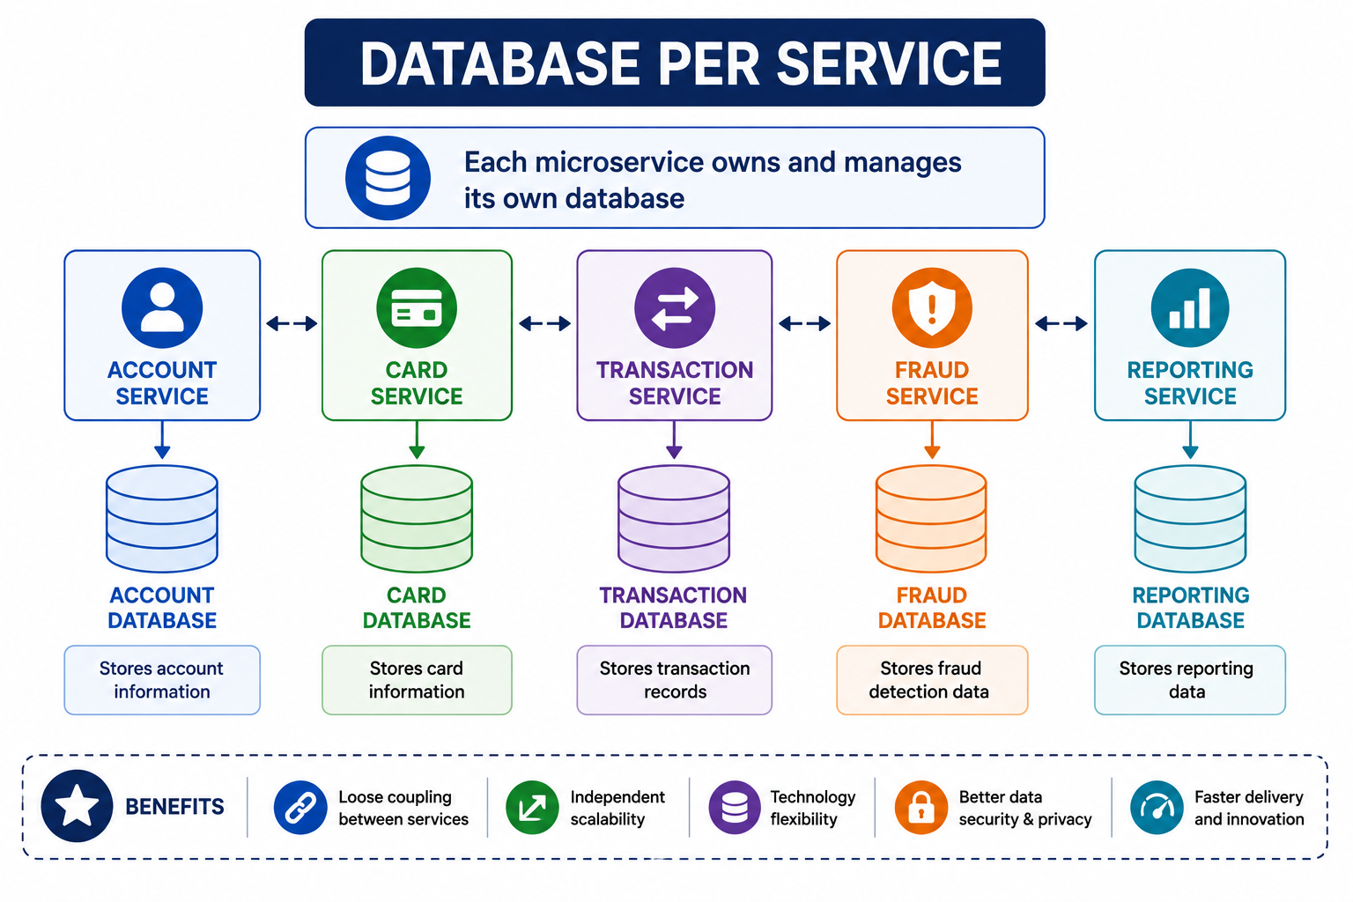
3
© 2026 by Innovation In Software Corporation
Notes:
KEY TALKING POINTS
------------------
- Service row and inter-service arrows
The five service boxes are connected by double-headed arrows.
Explain that those arrows represent API calls and events between services, not database links.
In the capstone, the real interactions are specific.
Transaction Service makes a REST GET to Account Service.
Transaction Service also publishes TransactionSubmitted events, which Risk Assessment Service will consume on Day 5.
Services are not wired to every neighbour.
Each dependency should have a reason.
- Per-service databases
Each service has exactly one downward arrow to its own database.
No arrows go from a service to someone else's cylinder.
That is the rule to remember.
In the labs, account_db stores account information.
transaction_db stores transaction records plus the processed_events table, which is used for duplicate detection.
On Day 5, risk_db stores risk scores and audit fields.
Card and Reporting are illustrative and not part of the capstone.
- Benefits band
The bottom band lists loose coupling, independent scalability, and technology flexibility.
It also lists better data security and privacy, and faster delivery.
Balance it with the costs, so the room does not leave with a one-sided view.
Reporting across services needs read models.
Business workflows that span services need sagas or events.
Data across services becomes eventually consistent, meaning copies agree after a short delay.
Those costs are the subject of the next part of Module 4.
REAL-WORLD EXAMPLES
-------------------
- Netflix has publicly described its move to cloud microservices.
In that design, services own their data and communicate through APIs.
The widely cited lesson for enterprises is about ownership boundaries.
Those boundaries, not the number of services, decide whether teams can deploy independently.
- In a bank, the reporting team usually receives data through extracts, events, or a warehouse feed.
It does not get direct access to the payments database.
That way operational performance and reporting needs do not compete.
USE-CASE SCENARIO
-----------------
During Lab 2, a participant asks a question.
Why does the Transaction Service not just add a foreign key from transactions.account_id to accounts.account_id?
Use this diagram to answer.
The two tables live in different databases owned by different services.
So a database-level foreign key cannot exist.
Instead, the REST call checks referential integrity, meaning the account really exists, at the moment of creation.
Later changes, such as a freeze, are Account Service's responsibility to publish.

Slide 5
SHARED DATABASE ANTI-PATTERN
A schema change made for one service can silently break every other service reading the same shared tables.
⚠️
WHY IT'S AN ANTI-PATTERN
• Multiple services become dependent on the same schema, tables, and release timing
• Cross-service queries and joins seem convenient but hide real coupling
• Designing service boundaries around database tables only leads to the same trap
KEY TAKEAWAY A schema change made for one service can silently break every other service reading the same shared tables.
4
© 2026 by Innovation In Software Corporation
Notes:
KEY TALKING POINTS
------------------
- WHY IT'S AN ANTI-PATTERN
There are three problems.
First, services that share a schema share its release timing.
Nobody can change a table without checking every consumer.
Second, cross-service joins feel convenient.
But they hide real dependencies that no API contract documents.
Third, drawing service boundaries around existing tables just recreates the monolith.
Tables reflect old storage decisions, not business capabilities.
Boundaries should come from the business domain first.
Then each service designs its own tables.
REAL-WORLD EXAMPLES
-------------------
- Here is a common enterprise story.
A nightly batch job reads an operational account table directly.
The owning team changes a column type, and the job fails overnight.
Statements are delayed.
Nothing in the application's API changed, so no contract test caught it.
- In retail banking, some core systems grew around one large shared schema.
They are often cited as a reason change is slow.
Every modification needs impact analysis across many dependent programs.
USE-CASE SCENARIO
-----------------
In the capstone, suppose Transaction Service had been allowed to join to the accounts table to check eligibility.
Later, the Account team moves nickname and status into a separate table to support audit history.
The join breaks.
Debits start failing with 500 errors, and the Transaction team never touched its code.
Now use the REST eligibility check from Lab 2 instead.
Account Service keeps the response contract stable while it changes its internal tables freely.

Slide 6
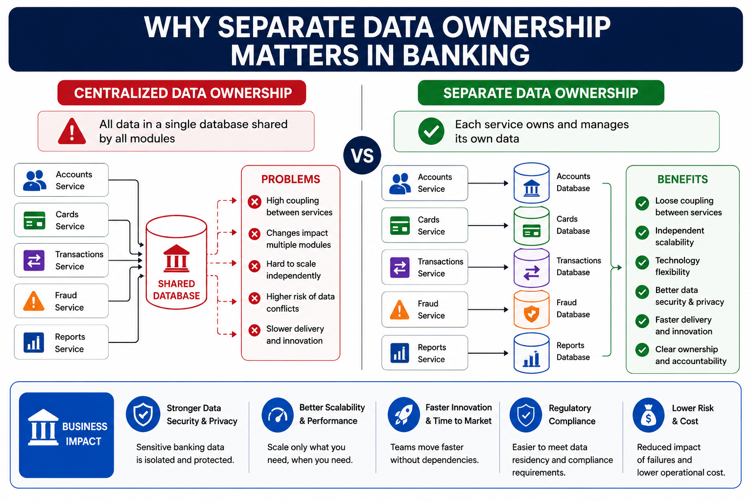
5
© 2026 by Innovation In Software Corporation
Notes:
KEY TALKING POINTS
------------------
- Centralized data ownership (left side)
All five services connect to one shared database.
Walk the red Problems list.
There is high coupling between services, and changes impact multiple modules.
One service cannot scale independently.
Data conflicts are more likely when two services update the same rows.
Delivery is slower because every change needs coordination.
Relate each problem to banking.
A Reports query can slow Transactions.
A Cards schema change can need sign-off from four teams.
- Separate data ownership (right side)
Each service has an arrow to its own database.
The green Benefits list covers loose coupling, independent scalability, and technology flexibility.
It also covers better data security and privacy, faster delivery, and clear ownership and accountability.
Map it to the capstone.
Accounts is Account Service with account_db.
Transactions is Transaction Service with transaction_db.
The Fraud box corresponds to our Risk Assessment Service with risk_db.
Cards and Reports are illustrative and are not built in the labs.
- Business impact band
The bottom band translates architecture into outcomes a bank cares about.
Sensitive data is isolated with narrower access.
Only what needs it gets scaled.
Teams move without waiting on each other.
Data residency and compliance conversations get easier.
When something fails, the blast radius, meaning how much breaks, is smaller.
Stress that separate databases help compliance by making access and ownership auditable.
But they do not make a system compliant on their own.
Controls, logging, and review still matter.
REAL-WORLD EXAMPLES
-------------------
- Card issuers typically keep cardholder data inside a tightly controlled environment.
That way fewer systems fall under PCI DSS scope, the card industry's security standard.
Put that data in a service that owns it, not in a shared schema many applications can read.
That is a practical way to limit the scope.
- Fraud screening platforms in banks usually maintain their own scoring data and case history.
Transaction events feed that data.
They do not query the payments database directly.
That way heavy analytical reads do not slow payment processing.
USE-CASE SCENARIO
-----------------
An internal auditor asks the risk platform team who can read risk scores.
With a shared database, the honest answer is every application with a connection string.
In the capstone, only Risk Assessment Service has credentials for risk_db.
Transaction Service only sees its own transaction_db.
Scores leave risk_db only through defined events or APIs.
So the team can answer the auditor with a short list of service accounts.
They do not need a spreadsheet of grants.

Slide 7
POLYGLOT PERSISTENCE
No single database is best for every workload -- Order Service, Payment Service, and Analytics Service can each pick their own fit-for-purpose store.
📌
EXAMPLE DATA STORE CHOICES
⚠️
CHALLENGES TO MANAGE
• Order Service -> PostgreSQL (relational, ACID, transactions, joins)
• Lecture only: some enterprises pick a document store for profiles -- this capstone uses PostgreSQL for every service
• Lecture only: Redis is a common cache -- Labs 1-5 do not install Redis
• Analytics Service -> Elasticsearch (full-text search, analytics)
• Increased operational complexity and more skills/tools to manage
• Data consistency across different stores; no joins across databases (use APIs or events)
KEY TAKEAWAY No single database is best for every workload -- Order Service, Payment Service, and Analytics Service can each pick their own fit-for-purpose store.
6
© 2026 by Innovation In Software Corporation
Notes:
KEY TALKING POINTS
------------------
- EXAMPLE DATA STORE CHOICES
The slide uses generic Order, Payment, and Analytics services, so translate them to banking.
A ledger or transaction service needs a relational, ACID store such as PostgreSQL.
ACID means transactions are all-or-nothing, consistent, isolated, and durable.
Some enterprises put customer profiles in a document store or use Redis as a cache.
Those are lecture-only here.
Search and analytics workloads sometimes use Elasticsearch.
In this capstone, Account, Transaction, and Risk Assessment each use their own PostgreSQL database.
Labs 1 to 5 install neither Redis nor Elasticsearch.
- CHALLENGES TO MANAGE
Every new store brings backups, patching, monitoring, and security hardening.
It also needs people who know how to run it.
That is why many banks keep a short approved-technology list.
Consistency also gets harder.
There are no joins across databases.
Combining data means calling APIs, consuming events, or building read models.
Encourage participants to default to the platform standard.
They should justify any exception with a workload need.
REAL-WORLD EXAMPLES
-------------------
- Online banking search is a common reason for a retail bank to add a search engine.
Customers search over years of transaction descriptions.
Events feed the search engine, which sits alongside the relational ledger.
The ledger remains the system of record for balances and postings.
- Branch and ATM locator data is read-heavy and changes rarely.
So teams often cache it in an in-memory store.
Account balances, by contrast, are poor cache candidates.
Stale values create customer and business risk.
USE-CASE SCENARIO
-----------------
Suppose the risk platform later needs analysts to search free-text notes on held transactions.
A team could skip adding text search to transaction_db.
Instead, it could build a separate search read model fed by TransactionHeldForReview events.
Walk through the cost.
There is a new store to secure and operate.
There is a lag before new holds appear in search.
And there is a new owner.
Then ask whether PostgreSQL full-text search inside Risk Assessment Service would be enough first.

Slide 8
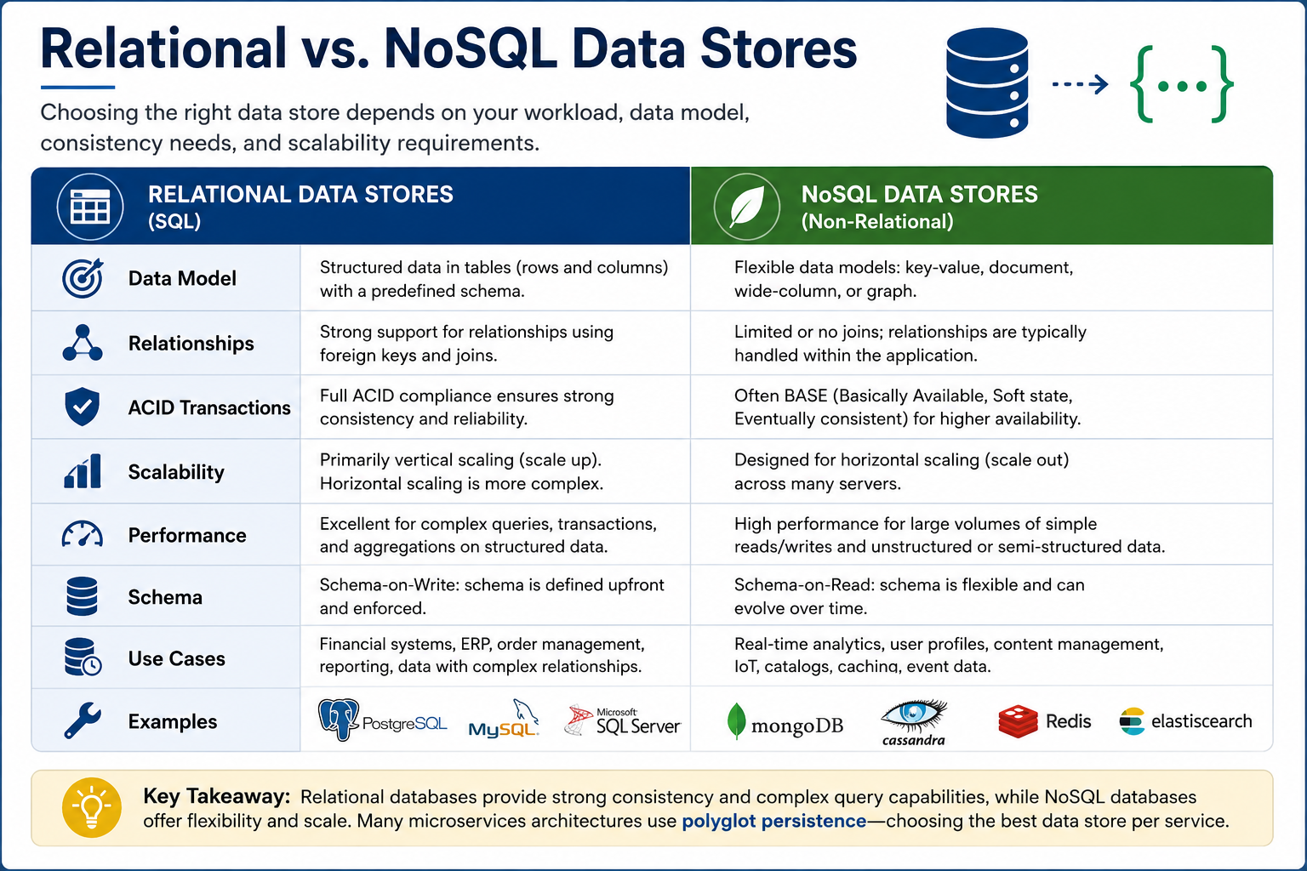
7
© 2026 by Innovation In Software Corporation
Notes:
KEY TALKING POINTS
------------------
- RELATIONAL VS. NOSQL
Relational stores use tables with a schema enforced on write.
They support joins and foreign keys and give full ACID transactions.
That suits ledgers and anything with money.
NoSQL stores offer key-value, document, wide-column, or graph models.
They often trade immediate consistency for availability and horizontal scale, known as BASE.
They suit catalogues, caching, IoT, and event data.
The vertical versus horizontal line is a generalisation.
PostgreSQL can scale reads with replicas, and some NoSQL products offer transactions.
The capstone uses PostgreSQL everywhere.
REAL-WORLD EXAMPLES
-------------------
- Banks typically keep payment postings and account ledgers in relational databases.
A debit and its matching entries must commit together or not at all.
Auditors also expect constraints that prevent half-written records.
- Key-value or document stores are common for some bank data.
Examples are customer session data, device fingerprints for login risk, or a product catalogue for a bank's marketing site.
That data is simple, high-volume, and tolerant of brief inconsistency.
USE-CASE SCENARIO
-----------------
In Lab 2, the transactions table has amount as NUMERIC(18, 2), a UNIQUE event_id, and a status column.
The consumer updates the transaction and inserts into processed_events in one local transaction.
Now ask about an eventually consistent store.
Suppose the status update succeeded, but the processed_events insert was not yet visible when a duplicate event arrived.
What would happen?
The answer shows why the capstone relies on relational ACID guarantees for duplicate detection.

Slide 9
SPRING DATA ARCHITECTURE · SPRING DATA JPA FUNDAMENTALS
📌
THE SPRING DATA LAYERS
📌
JPA FUNDAMENTALS
✅
BEST PRACTICES
• Your Spring Boot application -> Spring Data abstraction layer -> store-specific module -> data store
• Store modules: Spring Data JPA, Spring Data MongoDB, Spring Data Cassandra, Spring Data Redis
• Repository hierarchy: Repository -> CrudRepository -> PagingAndSortingRepository -> JpaRepository
• Entity: represents a database table, mapped with @Entity
• Primary key: identifies each entity uniquely, mapped with @Id
• Relationships: @OneToMany, @ManyToOne, @OneToOne map associations
• Persistence context: a first-level cache that tracks entity state within a transaction
• Prefer derived queries for simple use cases; use @Transactional on service-layer methods
• Avoid exposing repositories outside the service layer
KEY TAKEAWAY Repository abstraction, template abstraction, domain mapping, and query derivation work the same way whether the store is JPA, MongoDB, or Redis. • Define the entity, extend JpaRepository, and Spring Data JPA generates the SQL -- no boilerplate DAO code required.
8
© 2026 by Innovation In Software Corporation
Notes:
TOPIC 1 OF 2: Spring Data Architecture
--------------------------------------
KEY TALKING POINTS
------------------
- THE SPRING DATA LAYERS
Application code talks to repository interfaces.
Spring Data supplies the implementation through a store module such as Spring Data JPA, MongoDB, Cassandra, or Redis.
The store module then talks to the store.
The labs use only Spring Data JPA with Hibernate and PostgreSQL.
For Spring Boot 3, correct one detail on the hierarchy line.
Since Spring Data 3.0, PagingAndSortingRepository no longer extends CrudRepository.
JpaRepository extends ListCrudRepository and ListPagingAndSortingRepository.
So it still includes both CRUD and paging.
REAL-WORLD EXAMPLES
-------------------
- Enterprise teams that standardise on Spring often have a relational service using Spring Data JPA.
They may also have a cache-backed service using Spring Data Redis.
Developers moving between them recognise the same repository and derived-query style.
That shortens onboarding.
- When a bank upgrades older Spring Boot 2 services to Spring Boot 3, some code can fail to compile.
This is code that relied on PagingAndSortingRepository inheriting save or findById.
It is a commonly reported upgrade issue.
The fix is to also extend CrudRepository or ListCrudRepository.
USE-CASE SCENARIO
-----------------
In Lab 2, participants open TransactionRepository and ProcessedEventRepository.
They find both already extend JpaRepository.
So save, findById, and existsById are available without writing SQL.
The consumer calls processedEventRepository.existsById with the event ID to detect duplicates.
Point out that the Spring Data abstraction provides this one method name.
At runtime, Hibernate turns it into a SELECT against transaction_db.
TOPIC 2 OF 2: Spring Data JPA Fundamentals
------------------------------------------
KEY TALKING POINTS
------------------
- JPA FUNDAMENTALS
An entity is a Java class marked @Entity that maps to a table.
@Id marks the primary key.
In Lab 2, the Transaction entity maps to the transactions table.
Its transaction_id is a String, such as TXN- plus eight hex characters.
@OneToMany, @ManyToOne, and @OneToOne map associations.
But use them only between entities the same service owns.
The persistence context is a first-level cache per transaction.
It tracks loaded entities, so a changed entity is flushed, meaning written, as an UPDATE on commit.
- BEST PRACTICES
Use derived queries such as findByAccountId for simple lookups.
Reach for @Query only when names get unreadable.
Put @Transactional on public service-layer methods, as Lab 2 does on create and on the consumer.
Do not put it on controllers or repositories.
Keep repositories behind the service layer, so controllers never call them directly.
That keeps business rules such as the ACTIVE check in one place.
Return DTOs such as TransactionResponse from the API, not entities.
A DTO is a simple object shaped for the response.
REAL-WORLD EXAMPLES
-------------------
- Think of a loan origination service.
A derived query like findByApplicantIdAndStatus replaces hand-written JDBC code for a common lookup.
The approval workflow changes several tables, so it stays in a transactional service method.
There it can be reviewed and tested.
- A frequently seen production issue is a controller that returns a JPA entity with lazy associations as JSON.
That triggers extra queries or serialisation errors.
Mapping to a response DTO in the service layer avoids it.
USE-CASE SCENARIO
-----------------
Walk through Lab 2's consumer.
It is @Transactional.
It loads the Transaction by ID, calls markSubmitted, and saves a ProcessedEvent.
There is no explicit save call for the Transaction, yet the status becomes SUBMITTED.
Ask participants why.
The persistence context is tracking the managed entity.
Dirty checking, which compares the entity with its loaded state, notices the status change.
Hibernate then issues the UPDATE when the transaction commits, together with the processed_events insert.

Slide 10
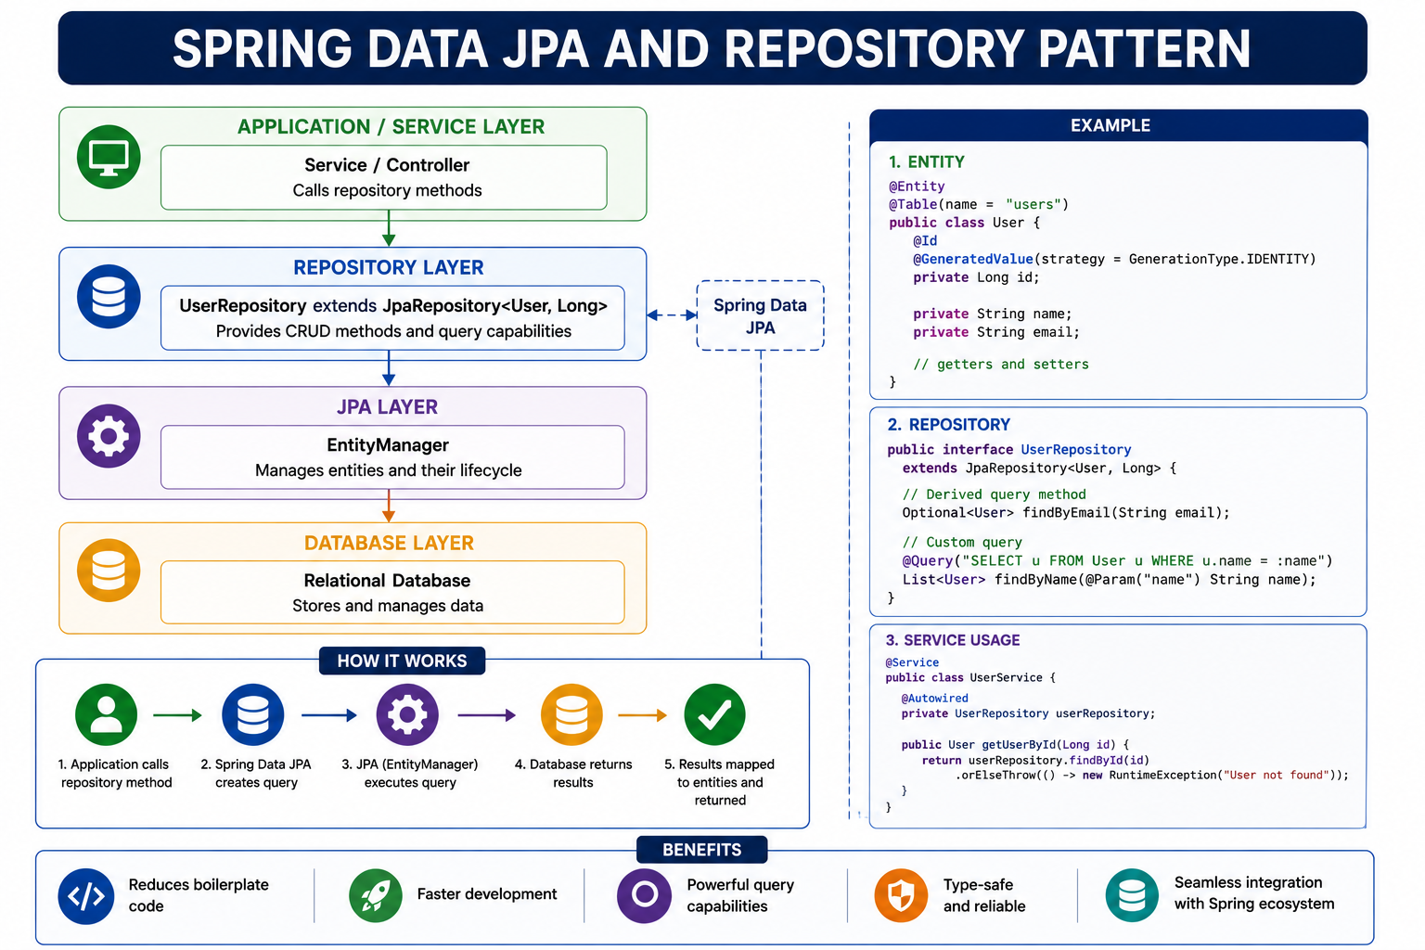
9
© 2026 by Innovation In Software Corporation
Notes:
KEY TALKING POINTS
------------------
- Layer stack
Service or controller code calls repository methods.
The repository interface extends JpaRepository and gets CRUD and query capabilities.
Spring Data JPA builds the implementation.
The EntityManager, provided by Hibernate, manages entity lifecycle and executes SQL.
PostgreSQL stores the data.
Add one correction to the top box.
In the course labs, controllers never call repositories directly.
Controllers call services, and services call repositories.
That keeps validation and business rules in one layer.
- How It Works flow
There are five steps.
The application calls a repository method.
Spring Data JPA creates the query from the method name or @Query.
JPA executes it through the EntityManager.
The database returns rows.
Then results are mapped to entities.
Connect it to Lab 2.
accountId eligibility is not in this flow at all, because it lives in another service.
But findById on the transactions table follows exactly these steps.
- Example code panels
The code uses a generic User entity, so translate it.
Entity becomes Transaction, with @Id on transactionId.
Repository becomes TransactionRepository extends JpaRepository of Transaction and String.
A derived query such as findByAccountId replaces findByEmail.
There are two style differences from the labs.
First, the example uses @Autowired field injection, but lab services use constructor injection.
Second, it throws a generic RuntimeException.
The labs throw specific exceptions such as TransactionNotFoundException, which map to a 404 error response.
- Benefits band
The band lists reduced boilerplate, faster development, powerful query capabilities, type safety, and Spring ecosystem integration.
Qualify the powerful queries claim.
Generated SQL still needs review.
A harmless-looking method can load large result sets or trigger N+1 queries, meaning one query plus one more per row.
Encourage participants to turn on SQL logging locally to see what Hibernate issues.
Keep it off in shared or production logs.
REAL-WORLD EXAMPLES
-------------------
- A bank's customer servicing application might need findByAccountIdAndStatus.
It would list pending transactions for a support agent.
A derived query delivers that in one line.
The agent-facing service then adds masking and authorisation rules before returning data.
- Some teams migrate legacy DAO classes full of hand-written JDBC to Spring Data JPA.
They often remove large amounts of repetitive mapping code.
But they typically keep a few native queries where tuned SQL matters for performance.
USE-CASE SCENARIO
-----------------
A participant in Lab 2 calls GET /api/v1/transactions/TXN-1A2B3C4D.
Trace it on the diagram.
TransactionController calls TransactionService.get, which is @Transactional with readOnly set.
The service calls transactionRepository.findById.
Hibernate issues a SELECT on transaction_db.
The row is mapped to a Transaction entity.
The service converts it to TransactionResponse.
A missing ID becomes TransactionNotFoundException and a 404, not a generic 500.

Slide 11
ENTITIES AND OBJECT-RELATIONAL MAPPING
The entity manager, persistence context, dirty checking, and SQL generation together turn changed Java objects into executed SQL statements.
📌
HOW ORM WORKS
✅
BEST PRACTICES
1. Entity manager manages the persistence context
2. Persistence context tracks entity states (managed, new, detached, removed)
3. Dirty checking detects changes in entities
4. ORM converts changes to SQL statements and executes them against the database
• Model the domain, not the database; keep entities small and focused
• Use appropriate fetch types (LAZY by default); keep business logic in the service layer, not the entity
KEY TAKEAWAY The entity manager, persistence context, dirty checking, and SQL generation together turn changed Java objects into executed SQL statements.
10
© 2026 by Innovation In Software Corporation
Notes:
KEY TALKING POINTS
------------------
- HOW ORM WORKS
The EntityManager owns a persistence context for the current transaction.
Entities are new before persist.
They are managed once loaded or saved.
They are detached after the context closes.
They are removed when marked for deletion.
At flush time, dirty checking compares managed entities with their loaded state.
Hibernate then writes UPDATE statements for the changes.
That is why Lab 2's consumer changes status through markSubmitted without an explicit save of the Transaction.
It is also why modifying a detached entity does nothing until it is merged.
- BEST PRACTICES
Model the business domain first, then design tables with Flyway.
Do not just mirror a legacy schema.
Keep entities small.
Lab 2's Transaction holds IDs, amount, currency, type, status, correlation and event IDs, and timestamps.
Treat LAZY by default as a recommendation, not the JPA default.
JPA makes @ManyToOne and @OneToOne EAGER, and @OneToMany and @ManyToMany LAZY.
Keep workflows in the service layer.
Small intention-revealing methods on the entity, such as markSubmitted, are fine.
REAL-WORLD EXAMPLES
-------------------
- In an account maintenance service, you load an account, change its status, and commit.
Dirty checking produces a single UPDATE.
A common bug goes differently.
A developer loads the entity in one transaction and returns it to a controller.
They modify it there and expect the change to persist.
- Some batch jobs load hundreds of thousands of entities into one persistence context, for example to recalculate interest.
They can run out of memory because the context keeps every entity.
Teams avoid this by flushing and clearing in chunks, or by using bulk SQL.
USE-CASE SCENARIO
-----------------
Ask participants to predict the SQL for Lab 2's create method.
transactionRepository.save on a new Transaction produces an INSERT into transactions.
That happens within the @Transactional boundary.
Then the event is published to Kafka.
Now ask what happens if the Kafka publish throws.
The exception propagates and the local transaction rolls back.
No RECEIVED row is left behind.
This is ORM plus transaction boundaries working together.
It also previews why the outbox pattern exists.

Slide 12
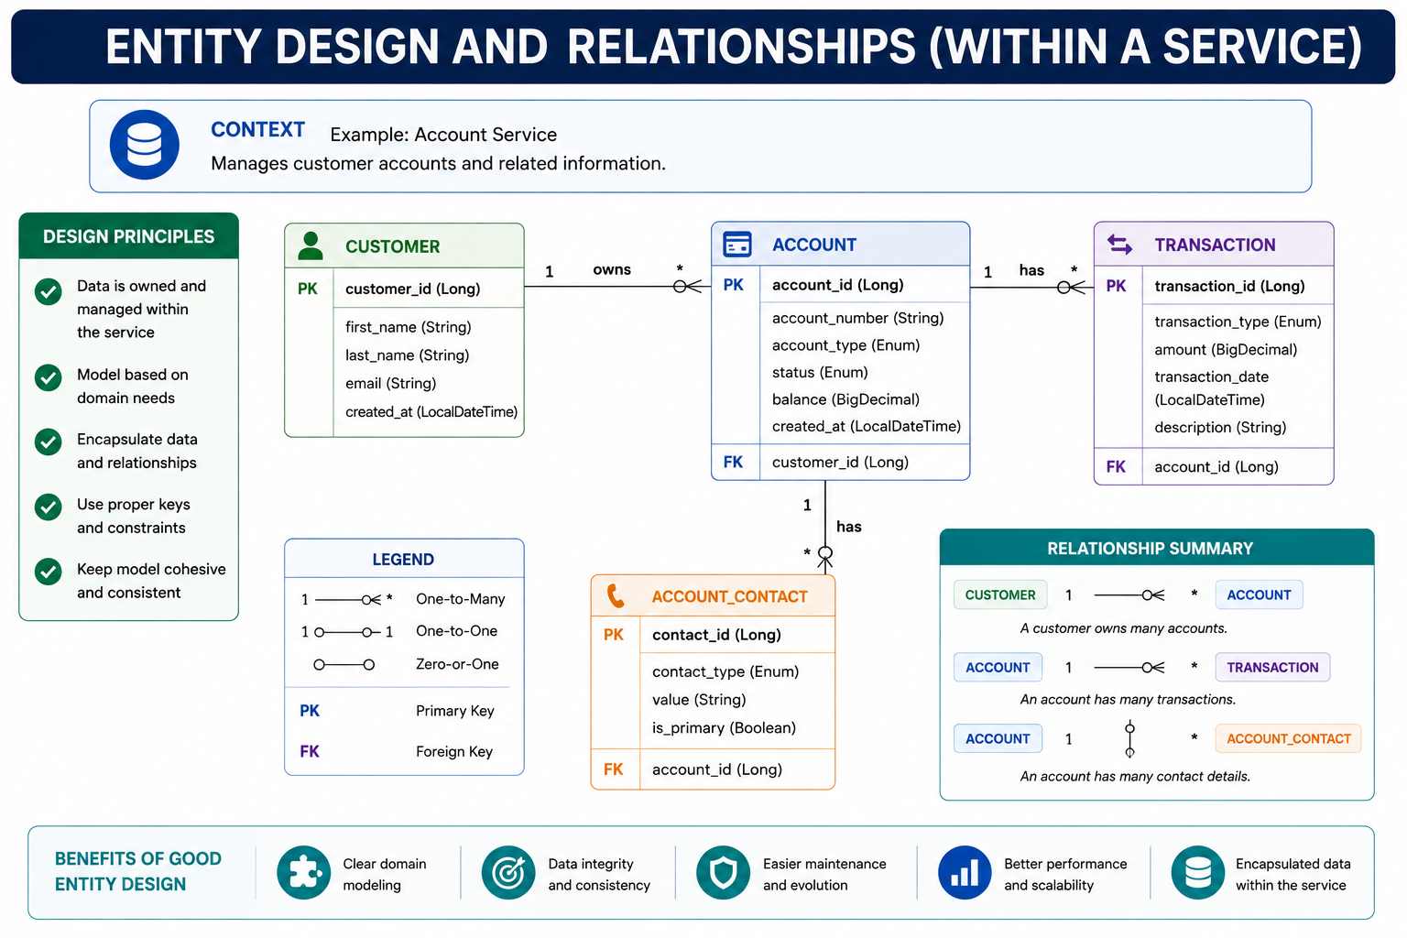
11
© 2026 by Innovation In Software Corporation
Notes:
KEY TALKING POINTS
------------------
- Context and design principles
The header says Account Service manages customer accounts and related information.
The left panel lists design principles.
Data is owned within the service and modelled on domain needs.
It is encapsulated, with proper keys and constraints, and cohesive.
The principles are sound.
Use them to test the diagram itself.
In the capstone, Account Service does not own Customer profile data or Transaction records.
So those fail the first principle.
- Entity boxes and relationships
The diagram shows that Customer owns many Accounts.
Account has many Transactions and many Account Contacts.
It uses Long IDs and a balance field.
Correct it against the labs.
Account Service stores customer_id as a plain VARCHAR, such as CUST-0001, with no customer table.
Lab 1 accounts have no balance column.
IDs are Strings, such as ACC- plus eight hex characters.
Transactions live in transaction_db, with account_id as a plain reference and no foreign key.
Account to Account Contact is a valid within-service relationship.
- Legend and relationship summary
The legend explains crow's-foot notation for one-to-many, one-to-one, and zero-or-one.
It also shows PK and FK markers.
The summary restates the three relationships in words.
Its Account to Account Contact connector is drawn differently from the one-to-many symbol, even though the text says many.
Use the legend to teach how a foreign key maps to JPA.
The child gets @ManyToOne with @JoinColumn.
The parent can optionally get @OneToMany with mappedBy.
- Benefits band
The band lists clear domain modelling, data integrity and consistency, and easier maintenance.
It also lists better performance and scalability, and encapsulated data within the service.
Make the point that integrity through foreign keys is available only inside one database.
Across services, integrity is enforced differently.
Lab 2 checks account eligibility with a REST call at creation time and records the result.
It accepts that later account changes are Account Service's to publish.
REAL-WORLD EXAMPLES
-------------------
- Inside a mortgage servicing system, a loan and its payment schedule entries are owned together.
They are a natural JPA one-to-many relationship.
The borrower's identity profile is owned by a customer or KYC (know your customer) system.
So it is referenced by an ID, not mapped as an entity.
- A common modernisation mistake is copying an entire legacy schema into the first new service.
That means customers, accounts, and transactions with all their foreign keys.
The service then becomes a new monolith that every other service depends on.
USE-CASE SCENARIO
-----------------
Run this as a quick redesign.
Tell the room a team built Account Service with this exact diagram.
Then Day 2 arrives, and Transaction Service needs its own transactions.
Ask what they must do.
They must remove the TRANSACTION entity and foreign key from account_db.
They must move transaction data into transaction_db.
They must replace the customer table with a customer_id reference.
And they must expose account status through the API.
Then show that Labs 1 and 2 already follow the redesigned model.

Slide 13
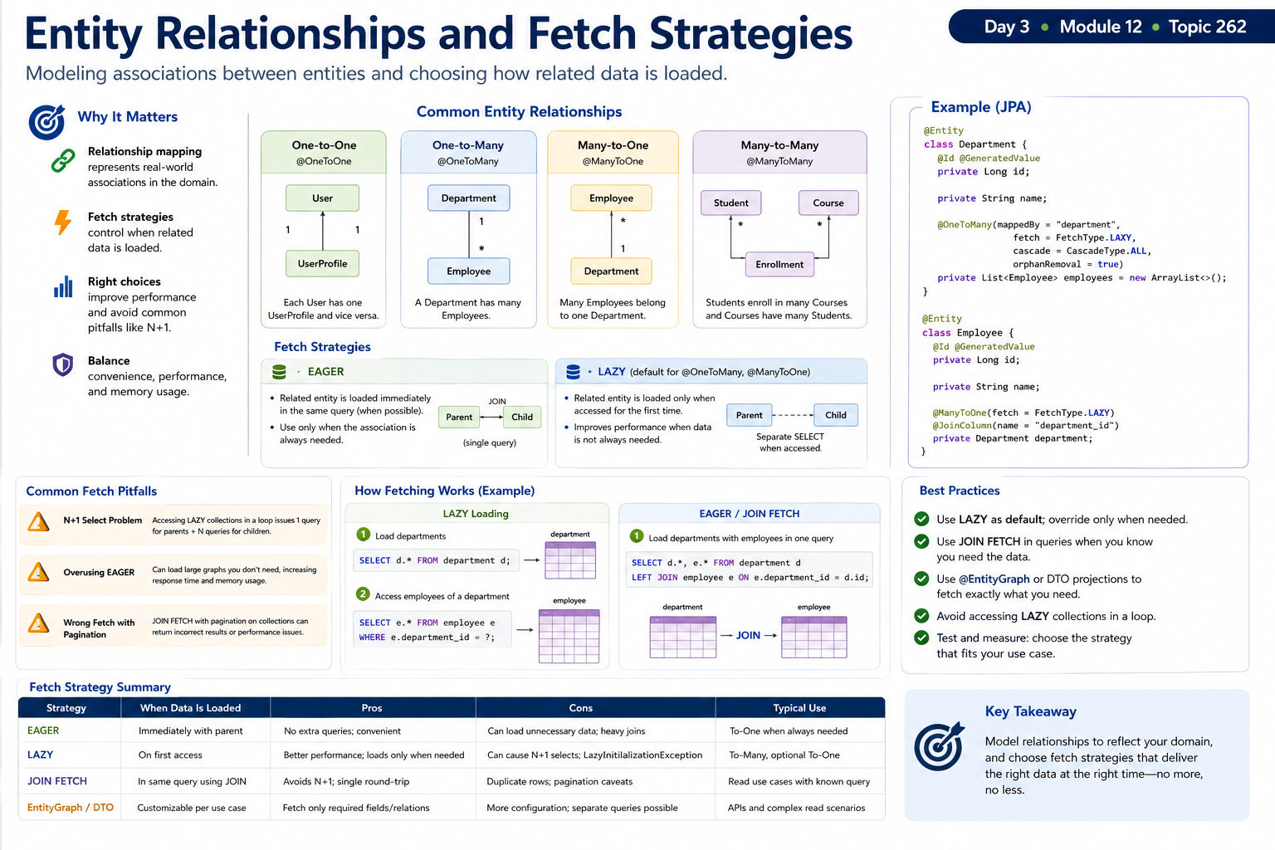
12
© 2026 by Innovation In Software Corporation
Notes:
KEY TALKING POINTS
------------------
- EAGER VS. LAZY
EAGER loads the association with its owner, often through a join.
Use it only when the data is always needed.
LAZY loads it on first access, usually through a proxy and a separate SELECT.
Correct the default.
JPA makes @OneToMany and @ManyToMany LAZY, but @ManyToOne and @OneToOne EAGER.
That is why the image's example sets fetch LAZY explicitly on @ManyToOne.
Accessing a LAZY association after the persistence context closes throws LazyInitializationException.
- COMMON FETCH PITFALLS
The N+1 problem works like this.
You load N parents with one query.
Then you touch a lazy collection on each and issue N more.
It hides in loops and in JSON serialisation of entities.
Fixes include a JOIN FETCH query, @EntityGraph, or a DTO projection that selects only the needed columns.
Overusing EAGER loads large object graphs on every read, which increases latency and memory.
The diagram adds a third pitfall.
JOIN FETCH on collections combined with pagination can return wrong page sizes or paginate in memory.
REAL-WORLD EXAMPLES
-------------------
- Picture a customer servicing screen that lists fifty accounts.
It then loads each account's contact details lazily inside a loop, which issues fifty-one queries.
Under peak call-centre load, this shows up as slow screens and database CPU spikes.
A join fetch or projection resolves it.
- Picture a statement service that maps every account with EAGER associations to all its transactions.
It can load years of history just to print a header.
That is why teams paginate transaction history and fetch it only for the requested period.
USE-CASE SCENARIO
-----------------
Lab 2 deliberately has no JPA relationships.
Transaction stores account_id as a String, and ProcessedEvent stores transaction_id.
So no lazy loading surprises exist.
Ask the room to imagine adding a Transaction to many TransactionNote entities for Day 5 human review.
A reviewer list page shows twenty held transactions with note counts.
That could trigger twenty-one queries.
Have them propose the fix: a DTO projection query that counts notes per transaction in one statement.

Slide 14
REPOSITORY ABSTRACTIONS
CrudRepository, PagingAndSortingRepository, and JpaRepository each add a layer of out-of-the-box CRUD, paging, and JPA-specific capability.
📌
WHY USE REPOSITORY ABSTRACTIONS
• Decouples business logic from data access implementation
• Consistent programming model across different data stores
• Easier testing with mock repositories; supports automation of common CRUD operations
KEY TAKEAWAY CrudRepository, PagingAndSortingRepository, and JpaRepository each add a layer of out-of-the-box CRUD, paging, and JPA-specific capability.
13
© 2026 by Innovation In Software Corporation
Notes:
KEY TALKING POINTS
------------------
- WHY USE REPOSITORY ABSTRACTIONS
The service depends on an interface such as TransactionRepository, not on SQL or the EntityManager.
So business rules read clearly, and storage details can change.
The same style works across Spring Data store modules.
Tests also become easier.
Lab 2's TransactionServiceTest can mock the repository and verify the service without a database.
For Spring Data 3, clarify the takeaway.
CrudRepository and PagingAndSortingRepository are separate interfaces.
JpaRepository combines list-returning CRUD, paging and sorting, and JPA extras such as flush.
REAL-WORLD EXAMPLES
-------------------
- A payments team might have a rule that a payment above a threshold goes to manual review.
They can unit test it by mocking the payment repository.
That runs thousands of fast tests without a database.
A smaller set of integration tests then covers the real SQL.
- Repositories should not hold business rules or publish events.
Picture a bank's servicing app where a repository method also sends notifications.
That makes both persistence and notification harder to test and to change.
USE-CASE SCENARIO
-----------------
In Lab 2, TransactionService depends on TransactionRepository, AccountClient, and the publisher.
In a unit test, the repository is mocked to return the saved entity.
AccountClient is mocked to throw AccountNotEligibleException for a FROZEN account.
The test asserts that neither save nor publish is called.
That single test proves the most important rule of the day: no row and no event for an ineligible account.
It only works because persistence sits behind an interface.

Slide 15
LAZY LOADING AND THE N+1 PROBLEM · QUERY METHODS AND CUSTOM QUERIES
⚠️
THE PROBLEM
✅
HOW TO AVOID IT
📌
FOUR QUERY APPROACHES
• 1 query to load N parents + N queries (one per parent's lazy collection) = N + 1 queries
• Common in REST APIs returning lists with nested data
• JOIN FETCH: fetch associations in the same query
• @EntityGraph, DTO projections, and batch fetching each solve it a different way
• Always profile real queries (Hibernate SQL logs, p6spy, Datasource proxy)
• Derived query methods: Spring Data parses the method name and builds the query automatically
• @Query (custom JPQL): for when the method name would be too long or unreadable
• Native SQL queries: for database-specific features or complex queries
• Named queries: reusable queries defined with @NamedQuery
KEY TAKEAWAY Loading N parent records and then accessing a lazy collection on each one issues 1 + N queries -- and performance degrades as N grows. • findByEmail, findByStatus, and findByNameContaining are parsed straight from the method name -- no query code required.
14
© 2026 by Innovation In Software Corporation
Notes:
TOPIC 1 OF 2: Lazy Loading and the N+1 Problem
------------------------------------------
KEY TALKING POINTS
------------------
- THE PROBLEM
Make the arithmetic concrete with a relationship owned inside one service.
A ledger entity with its entries works well.
Say an endpoint returns 50 ledgers.
While it maps each one to JSON, it reads that ledger's entries.
Hibernate runs one SELECT for the ledgers.
Then it runs 50 more, one for each collection.
That is 51 round trips where one or two would do.
With ten test rows, nobody notices.
With real statement data, latency climbs.
Each request also holds a pooled connection longer.
Tell the room it hides in REST list endpoints.
A lazy field loads only when code first reads it.
Serialization, or DTO mapping into response objects, touches that field quietly, far away from the repository call.
- HOW TO AVOID IT
Each fix trades something.
JOIN FETCH in a JPQL query loads parents and the collection in one SQL join.
But if you combine a collection fetch with pagination, Hibernate paginates in memory.
@EntityGraph on a repository method says which associations to load for that call only.
It does not change the entity mapping.
DTO projections select just the columns the response needs.
They skip entity loading entirely.
Batch fetching loads lazy collections in groups, using IN clauses.
You turn it on with @BatchSize or the hibernate.default_batch_fetch_size property.
Whatever the fix, prove it.
Count the logged SQL statements, and do not rely on intuition.
REAL-WORLD EXAMPLES
-------------------
- An online banking statement page lists recent statements.
Each statement has its line items.
Suppose the statement entity maps its lines lazily.
The serializer then walks them one statement at a time.
A single page view becomes dozens of queries.
Teams usually catch it by turning on SQL logging in a test.
Then they count the SELECTs per request.
- Hibernate's user guide recommends lazy associations.
It says to fetch what each use case needs per query, using fetch joins or entity graphs.
Tools such as p6spy and datasource-proxy wrap the JDBC DataSource and log every statement.
So teams can write automated tests that check an endpoint issues a fixed number of queries.
USE-CASE SCENARIO
-----------------
In Lab 2, Transaction Service stores account_id as a plain column.
It has no JPA relationship to Account Service, exactly as database per service requires.
Now imagine a teammate adds a status-history child entity inside Transaction Service.
They also add a GET endpoint that lists 200 transactions for an account, with their history.
Response time jumps.
The SQL log shows 201 SELECTs.
The fix is an @EntityGraph on the repository method, or a DTO projection.
Either one brings it back to one or two queries.
Then point out the cross-service twin of this bug.
Calling Account Service once per transaction row, in a loop, is an N+1 over HTTP.
Every row shares one accountId, so a single call is enough.
TOPIC 2 OF 2: Query Methods and Custom Queries
------------------------------------------
KEY TALKING POINTS
------------------
- FOUR QUERY APPROACHES
Derived methods are the default.
Spring Data reads a method name such as findByStatus and generates the query.
It checks the property names when the repository is created at startup, so a typo fails fast.
Once a name strings together several conditions, switch to @Query with JPQL.
JPQL is a query language that targets entity and field names, and it stays portable.
Use native SQL, set with nativeQuery = true, for PostgreSQL-specific features.
Examples are JSONB operators or window functions.
The cost is portability.
Named queries live on the entity with @NamedQuery.
They are less common in Spring Data code, but they still show up in older codebases.
REAL-WORLD EXAMPLES
-------------------
- Account lookups fit derived methods well.
A repository method such as findByCustomerId returns every account for a synthetic customer like CUST-0001, backed by the idx_accounts_customer_id index.
Lab 1's Flyway migration already creates that index.
No hand-written query is needed.
- Reporting-style queries usually outgrow method names.
One example is summing posted amounts per day for one account.
Teams write these in JPQL with @Query.
They use native SQL when they need PostgreSQL functions like date_trunc.
Either way, they return a DTO projection instead of full entities.
USE-CASE SCENARIO
-----------------
Lab 2's TransactionRepository gets save and findById free from JpaRepository.
The lab's troubleshooting table mentions transactions stuck in RECEIVED when the consumer fails.
An operations engineer asks for a query.
It should list RECEIVED transactions older than five minutes for an account.
A derived method, findByAccountIdAndStatusAndCreatedAtBefore, is still readable.
It uses the idx_transactions_account_id and idx_transactions_status indexes from the V1 migration.
Next they want a count of transactions per status across all accounts.
That needs GROUP BY, so it becomes an @Query in JPQL that returns a small projection.
Each time, the team uses the simplest option that stays readable.

Slide 16
DATABASE CONNECTION POOLING · SCHEMA MIGRATION WITH FLYWAY OR LIQUIBASE
📌
WHY POOLING MATTERS
✅
KEY HIKARICP SETTINGS
• Establishing a DB connection is expensive (network handshake, authentication)
• Pooling reuses connections, reducing latency and improving throughput
• Prevents exhausting database connections and improves scalability under load
• maximum-pool-size, minimum-idle, connection-timeout, idle-timeout, max-lifetime
• Right-size the pool to match database capacity and workload
📌
FLYWAY VS. LIQUIBASE
✅
BEST PRACTICES
• Flyway: SQL-first, simple learning curve, manual (SQL) rollback
• Liquibase: SQL, XML, YAML, or Java changesets; more extensible, built-in rollback support
• Always version control migration files; make migrations small, atomic, and focused
• Never edit a migration that has already been applied
KEY TAKEAWAY HikariCP, Spring Boot's default pool, cuts latency and prevents connection exhaustion by reusing a right-sized pool of connections. • Flyway and Liquibase both track applied migrations in a history table so every environment ends up on the exact same schema version.
15
© 2026 by Innovation In Software Corporation
Notes:
TOPIC 1 OF 2: Database Connection Pooling
-----------------------------------------
KEY TALKING POINTS
------------------
- WHY POOLING MATTERS
Opening a PostgreSQL connection takes several steps.
There is a TCP handshake, often TLS, authentication, and a new server-side backend process.
That costs far more than a simple query.
A pool opens connections once and lends them to requests.
So each request pays only for its SQL.
The pool is also a safety valve.
PostgreSQL caps connections with max_connections.
Without a pool, a traffic spike or a scaled-out deployment can use up that limit.
Then every client of the server is locked out.
With a pool, requests beyond its size wait briefly.
They do not overwhelm the database.
- KEY HIKARICP SETTINGS
In Spring Boot, these settings sit under spring.datasource.hikari.
maximum-pool-size caps open connections and defaults to 10.
minimum-idle keeps warm connections ready.
HikariCP's documentation suggests leaving it unset, so the pool stays a fixed size.
connection-timeout is how long a request waits for a free connection before it fails.
idle-timeout retires unused extra connections.
max-lifetime recycles connections before a database or firewall silently drops them.
Right-sizing is multiplication.
Pool size times pod replicas must stay within what the database allows.
This matters when an OpenShift deployment scales out.
REAL-WORLD EXAMPLES
-------------------
- A card authorization service scales its pods horizontally on a busy shopping day.
Suppose every pod keeps a large pool.
Together, those connections exceed the database limit.
New pods then fail to connect while old ones keep working.
Sizing each pod's pool against the database's total connection budget prevents this.
- HikariCP's project wiki has an article on pool sizing.
It argues that smaller pools often outperform large ones.
The reason is that a database can only run so much work in parallel.
Spring Boot teams commonly start at the default.
Then they tune using Micrometer's hikaricp metrics, such as active and pending connections.
Those metrics are exposed through Actuator, Spring Boot's monitoring endpoints.
USE-CASE SCENARIO
-----------------
In Lab 2, TransactionService.create runs inside one transaction.
It calls Account Service over REST and inserts the row.
Then it waits up to 5 seconds for Kafka to acknowledge the event.
Picture the broker becoming slow.
Every create request now holds a pooled connection for seconds.
The default pool has 10 connections.
So the eleventh concurrent request waits on connection-timeout.
The API looks broken, even though PostgreSQL itself is idle.
The pending-connections metric climbs.
Give the team the lesson.
Pool exhaustion is often a symptom of long transactions, not of a pool that is too small.
Raising the pool size would only move the pressure onto the database.
TOPIC 2 OF 2: Schema Migration with Flyway or Liquibase
------------------------------------------
KEY TALKING POINTS
------------------
- FLYWAY VS. LIQUIBASE
Flyway runs plain SQL files named by version, such as V1__create_transactions.sql, in order.
It records each one in flyway_schema_history.
That is why the capstone uses it: engineers review ordinary PostgreSQL DDL, the statements that create and change tables.
In the open-source edition, undoing a change means writing a new forward migration.
Undo migrations are a commercial Flyway feature.
Liquibase keeps changesets in a changelog written in SQL, XML, YAML, or JSON.
It records them in DATABASECHANGELOG.
It can generate rollback for many change types automatically.
But raw SQL changesets need their rollback written by hand.
Spring Boot auto-configures either tool.
- BEST PRACTICES
Migrations live in Git under src/main/resources/db/migration.
So a schema change and the entity change that needs it ship in one reviewed commit.
Keep each file small and single-purpose, such as one column or one index.
Then a failure is easy to diagnose.
Never edit an applied migration.
Flyway stores a checksum and fails validation at startup if the file changed.
That stops environments from silently drifting apart.
Fix mistakes with a new V2 file.
Pair this with ddl-auto set to validate, as Labs 1 and 2 do.
Then Hibernate checks the schema but never changes it.
REAL-WORLD EXAMPLES
-------------------
- Banks generally require schema changes to pass change management with an audit trail.
Versioned migration files live in Git and are reviewed in pull requests.
The pipeline applies them, and nobody runs scripts by hand.
Auditors can see the exact DDL, its author, and the order in which it reached production.
- Here is a classic failure.
A developer fixes a typo in a V3 script that was already applied.
Environments that ran the old version now fail Flyway checksum validation at startup.
Fresh environments, meanwhile, get different DDL.
The correct repair is a new V4 migration that makes the correction explicit.
USE-CASE SCENARIO
-----------------
In Lab 2 Step 2, learners create V1__create_transactions.sql, the file that builds the transactions table, two indexes, and the processed_events inbox table.
On restart, the log reports migrating schema public to version 1.
Now imagine the product owner asks to record the channel a transaction came from, such as mobile or branch.
A learner is tempted to add the column to V1.
But V1 is already applied on every laptop, so Flyway would reject the changed checksum.
Instead they write V2__add_transaction_channel.sql, add the field to the entity, and restart.
Because ddl-auto is validate, forgetting either half fails at startup instead of in production.

Slide 17
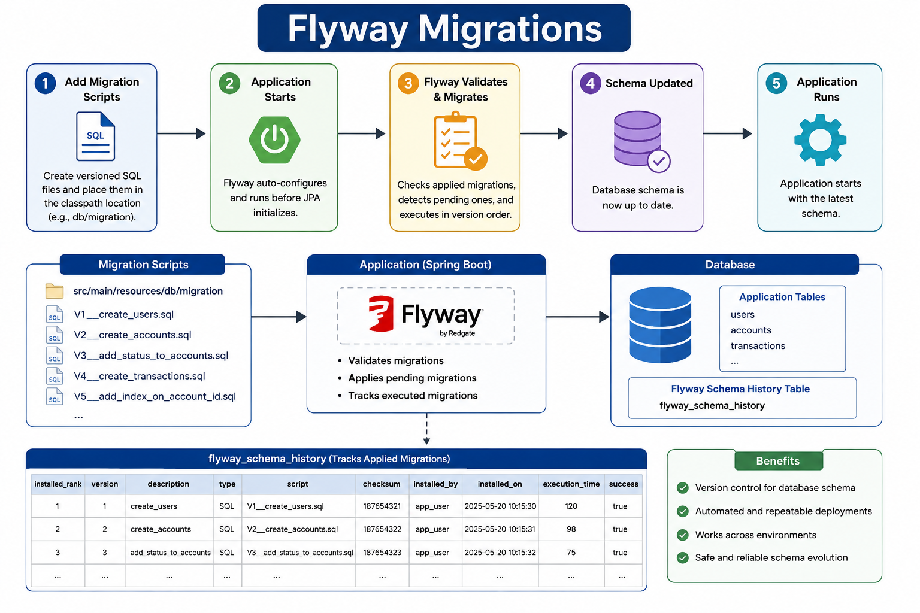
16
© 2026 by Innovation In Software Corporation
Notes:
KEY TALKING POINTS
------------------
- Five-step startup flow
Participants create versioned SQL files under src/main/resources/db/migration.
When Spring Boot starts, Flyway is auto-configured and runs before JPA initialises.
It checks which versions are already applied.
It runs pending ones in version order.
Only then does the application finish starting.
Connect it to the labs.
ddl-auto is set to validate.
So if a Flyway script and the entity disagree, startup fails loudly.
Hibernate does not silently alter tables instead.
- Migration scripts, application, and database
File names follow V, a version number, two underscores, and a description.
The example folder mixes users, accounts, and transactions in one service.
That is fine for a generic illustration, but not for the capstone.
In the labs, each service has its own V1 file.
Lab 1 has V1__create_accounts.sql in account_db.
Lab 2 has V1__create_transactions.sql, which creates transactions and processed_events in transaction_db.
The database keeps application tables alongside flyway_schema_history.
- flyway_schema_history table
Each applied migration is recorded with rank, version, description, script, and checksum.
It also records the installing user, time, duration, and success.
The rows on the image are illustrative sample values.
In practice the checksum, a fingerprint of the file, matters most.
If someone edits an already applied V1 file, validation fails on the next start.
The fix is a new V2 migration, never editing history.
That is the discipline auditors expect for schema changes.
- Benefits panel
The panel lists version control for the schema, automated and repeatable deployments, consistency across environments, and safe schema evolution.
Tie it to later days.
On Day 4, the same container image runs in OpenShift, and Flyway applies the same migrations there.
So development and cluster databases converge.
Remind participants that migrations must be backward compatible.
Old and new pods run side by side during a rollout.
REAL-WORLD EXAMPLES
-------------------
- Banks commonly require schema changes to go through the same review and change management as application code.
Versioned migration files in the service repository give reviewers a readable diff.
They also give auditors a history table showing exactly when each change was applied.
- A frequent production incident starts with a hotfix applied by hand to one environment's database.
The next automated deployment then fails.
Teams using Flyway avoid that.
They route even urgent schema fixes through a new migration version.
USE-CASE SCENARIO
-----------------
Later, the risk platform needs a merchant category column on transactions.
A participant is tempted to edit V1__create_transactions.sql.
Walk through the result.
Every database that already applied V1 now has a Flyway checksum that no longer matches, so startup fails.
The right move is V2__add_merchant_category.sql with an ALTER TABLE that adds a nullable column.
Also update the Transaction entity.
Then ddl-auto validate confirms they match on the next start.

Slide 18
DATABASE CONFIGURATION ACROSS ENVIRONMENTS · LOCAL TRANSACTIONS WITH SPRING
📌
TYPICAL ENVIRONMENTS
🔒
BEST PRACTICES
• Development: local or shared DB for developer productivity
• Test/QA: isolated DB for testing and automation
• Staging/UAT: production-like for final validation
• Production: highly available and secured
• Never commit passwords or URLs; use environment variables or a secrets manager
• Use the least-privilege DB user and validate configuration at startup
📌
HOW A LOCAL TRANSACTION WORKS
✅
BEST PRACTICES
• Service layer begins a transaction, executes operations, then commits or rolls back
• Default propagation is REQUIRED; runtime exceptions trigger rollback by default
• Managed by Spring's PlatformTransactionManager, applied via @Transactional
• Keep transactions short and focused; use @Transactional at the service layer
• Do not perform remote calls (REST, messaging) inside a transaction
KEY TAKEAWAY application-dev.yml, application-qa.yml, and application-prod.yml each point at a different database with different pool sizing and logging. • If any operation inside a @Transactional service method throws, Spring rolls back every change made earlier in that same method.
17
© 2026 by Innovation In Software Corporation
Notes:
TOPIC 1 OF 2: Database Configuration Across Environments
------------------------------------------
KEY TALKING POINTS
------------------
- TYPICAL ENVIRONMENTS
The same jar should run everywhere.
Only the configuration changes.
Development favours speed.
In Lab 1, the local profile's YAML points Account Service at PostgreSQL on host port 5433, and Lab 2 uses transaction_db on 5434.
Test or QA needs an isolated database.
Automation should be able to reset it without hurting anyone.
Staging or UAT mirrors production's database version, schema, and configuration shape.
So migration or performance surprises appear before release.
Production adds high availability, backups, encryption, and tightly restricted access.
It is the only place real customer data should exist.
- BEST PRACTICES
Connection URLs and credentials differ per environment, and they are sensitive.
So the YAML holds placeholders.
The real values arrive from environment variables, an OpenShift Secret, or a vault.
Least privilege means the application's user can read and write its own tables.
It cannot drop the schema.
Flyway can run with a separate, more privileged user.
Validating at startup means failing fast.
Flyway validation, ddl-auto validate, and @Validated configuration properties all stop a misconfigured pod before it takes traffic.
That fits the readiness probes learners wire on Day 4.
REAL-WORLD EXAMPLES
-------------------
- Banks typically enforce a separation between production and non-production data.
A common control is that production database credentials exist only in the production secrets store.
So a developer laptop or a QA pipeline cannot reach production, even if someone selects the wrong profile.
- Credentials committed to source repositories are a recurring cause of security incidents.
That is why GitHub offers secret scanning, which flags committed keys and passwords.
When application YAML holds only placeholders, a scan of the repository finds nothing worth stealing.
USE-CASE SCENARIO
-----------------
Transaction Service has to run in three places.
The first is a laptop.
There it uses port 5434 for transaction_db and localhost:8081 for Account Service.
The second is a QA namespace, and the third is production on OpenShift.
A teammate hardcodes the JDBC URL and password in application.yml to save time.
The QA deployment tries to reach localhost and crashes.
The password now sits in Git history too.
The fix keeps one application.yml with placeholders.
Each environment supplies SPRING_DATASOURCE_URL, plus the username and password from a Secret.
It also supplies the Account Service base URL through an environment variable.
The build artifact never changes between environments.
TOPIC 2 OF 2: Local Transactions with Spring
------------------------------------------
KEY TALKING POINTS
------------------
- HOW A LOCAL TRANSACTION WORKS
@Transactional puts a proxy around the service bean.
A proxy is a wrapper that runs code before and after each call.
When a call enters, the proxy asks the PlatformTransactionManager to begin a transaction.
In a JPA application, that manager is JpaTransactionManager.
It binds a connection to the thread, and repository calls reuse it.
A normal return commits.
An unchecked exception, meaning RuntimeException or Error, rolls back.
Checked exceptions commit unless rollbackFor says otherwise.
REQUIRED means an inner @Transactional call joins the outer transaction.
This is all proxy-based.
So if one method calls a @Transactional method in the same class, the call skips the proxy entirely.
- BEST PRACTICES
The service layer knows the business unit of work.
So the annotation belongs there, not on controllers.
Short transactions release row locks and pooled connections quickly.
Remote calls inside a transaction hurt twice.
First, a slow dependency holds the connection for its whole latency.
Second, a rollback cannot undo a REST call or published event that already happened.
Be ready to explain that Lab 2's create method simplifies this on purpose.
It calls Account Service and waits for the Kafka acknowledgement inside the transaction.
It relies on client timeouts and a 5 second publish limit.
The production-grade answer is the transactional outbox.
REAL-WORLD EXAMPLES
-------------------
- An internal transfer between two accounts in the same ledger database is the textbook local transaction.
Debit one balance, credit the other, and write an audit row.
If the credit fails, the debit must not survive.
One @Transactional service method guarantees that, with no coordination protocol.
- Here is a frequent production bug.
A service catches an exception inside a @Transactional method, logs it, and returns normally.
Spring sees no exception, so it commits the half-finished work.
When the business operation has failed, rethrow the exception.
Or mark the transaction rollback-only.
USE-CASE SCENARIO
-----------------
Walk through Lab 2's create method.
It inserts the transaction row with status RECEIVED.
Then it publishes TransactionSubmitted and waits for the broker.
Suppose Kafka is down.
The publisher throws IllegalStateException, which is a runtime exception, so Spring rolls back the insert.
The client gets an error, and no silent RECEIVED row is left behind.
That is exactly what the lab guide intends.
Then ask about the opposite gap.
The broker acknowledges the event, but the commit fails afterward.
Now an event exists for a row that does not.
The consumer cannot find the transactionId.
It retries twice, and the message lands on the dead-letter topic, a holding topic for failed messages.
That dual-write gap is what the transactional outbox closes.

Slide 19
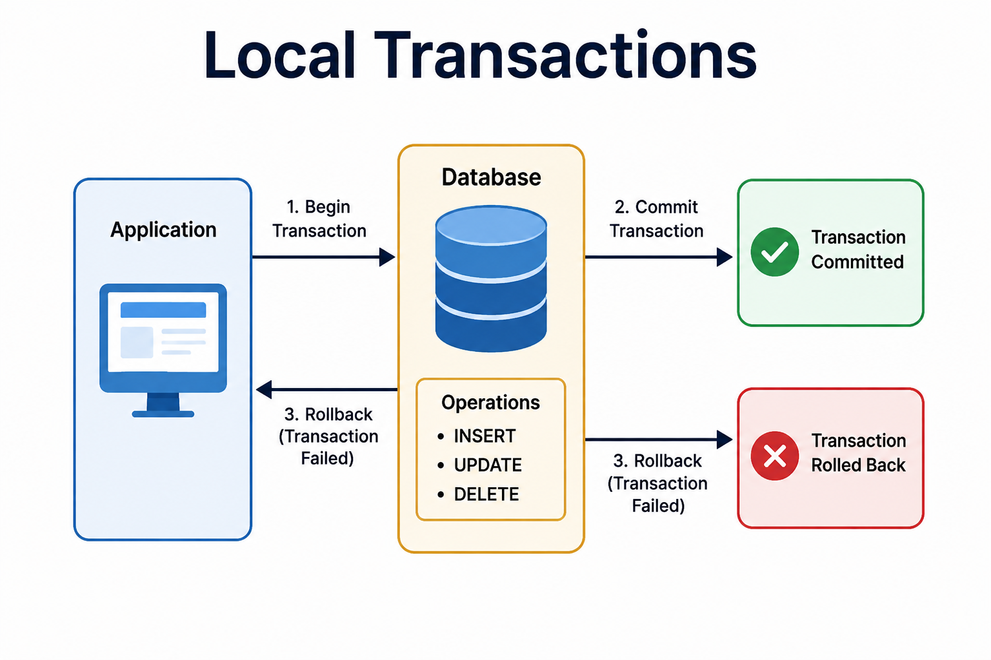
18
© 2026 by Innovation In Software Corporation
Notes:
KEY TALKING POINTS
------------------
- Application
The left box stands for a Spring service method annotated with @Transactional.
Examples are create in Lab 2's TransactionService, or an account status change in Lab 1.
Stress that the application decides when to begin, commit, or roll back.
It does this through Spring's transaction manager.
The database does not decide on its own when a business operation is finished.
It runs statements and reports errors, such as a constraint violation or deadlock.
The application then reacts to them.
- Database and Operations
The centre box shows the statements that run on one connection within one transaction.
Until commit, other sessions cannot see these changes at PostgreSQL's default Read Committed level.
The INSERT, UPDATE, and DELETE list is generic SQL.
Remind learners that the capstone never physically deletes an account.
Lab 1 closes it by status, because banking audit needs the record.
The key point is that all listed operations share a single fate.
- Commit path
The green outcome means every statement is now durable and visible to other transactions.
Only after commit should anything downstream rely on the data.
In Lab 2, that is why the event consumer looks up the transaction row.
A row that never committed does not exist from any other connection's point of view.
Commit is also when JPA flushes pending entity changes, meaning it sends them to the database.
That is why Lab 1 needs no explicit save after changing a field.
- Rollback path
The red outcome is triggered by a runtime exception in the service method, or by an error from the database.
The engine discards every change made in the transaction.
The exception travels back to the application.
There, a controller advice turns it into an HTTP error response.
Correct the numbering on the image.
Commit and rollback are alternative outcomes after the operations run.
They are not steps two and three of one sequence.
A transaction ends in exactly one of them.
REAL-WORLD EXAMPLES
-------------------
- Opening an account inside one core banking database often means three inserts.
There is the account record, an opening-balance record, and an audit entry.
If the audit insert fails, the bank does not want an account with no audit trail.
So all three statements run in one local transaction.
- At an ATM, the core system posts a withdrawal.
The posting typically updates the available balance and writes a ledger entry together.
A failure between those two statements would leave the ledger and the balance disagreeing.
A single local transaction prevents exactly that.
USE-CASE SCENARIO
-----------------
Lab 2's Kafka consumer is a compact example of this diagram.
Its consume method is @Transactional.
It changes the transaction's status from RECEIVED to SUBMITTED.
It also inserts a row into processed_events keyed by event_id.
Both changes go down the commit arrow together.
Now suppose the processed_events insert fails.
For example, a replay of the same event raced in, and the event_id primary key already exists.
The whole transaction takes the rollback arrow, so the status update disappears too.
Kafka's retry handling then takes over.
Without one local transaction, the row could be marked SUBMITTED with no record that the event was processed.
That would break the lab's idempotency guarantee, the promise that a repeated event has no extra effect.

Slide 20
TRANSACTION PROPAGATION · TRANSACTION ISOLATION LEVELS
📌 THE FOUR SQL ISOLATION LEVELS
LEVEL | PREVENTS | CONCURRENCY
Read Uncommitted | Nothing | Highest
Read Committed | Dirty reads | High (most systems' default)
Repeatable Read | Dirty + non-repeatable reads | Medium
Serializable | Dirty + non-repeatable + phantom reads | Lowest
📌
KEY PROPAGATION TYPES
• REQUIRED (default): join the existing transaction, or create a new one
• REQUIRES_NEW: suspend any existing transaction and start an independent one
• MANDATORY: must run inside an existing transaction, or throw an exception
• NEVER: must not run inside a transaction at all
KEY TAKEAWAY REQUIRED is the sensible default for most business operations; REQUIRES_NEW isolates audit logging or notifications from the main transaction. • READ COMMITTED is the default for most systems and balances consistency against concurrency; SERIALIZABLE trades concurrency for full correctness.
19
© 2026 by Innovation In Software Corporation
Notes:
TOPIC 1 OF 2: Transaction Propagation
-------------------------------------
KEY TALKING POINTS
------------------
- KEY PROPAGATION TYPES
Propagation decides what happens when one transactional method calls another.
REQUIRED is the default.
It joins the caller's transaction, so both commit or roll back together.
REQUIRES_NEW suspends the caller and commits its own work independently.
That is useful for an audit row that must survive a failed business operation.
But it holds a second pooled connection at the same time.
MANDATORY throws if no transaction exists.
It protects helpers that must never run alone.
NEVER throws if a transaction does exist, which guards slow remote-call methods.
Spring defines seven options in total.
SUPPORTS, NOT_SUPPORTED, and NESTED complete the set.
REAL-WORLD EXAMPLES
-------------------
- Security and compliance teams usually want a record of every declined transfer attempt.
Suppose the transfer rolls back.
An audit writer using REQUIRED would roll back with it, and the evidence would vanish.
Running the audit write with REQUIRES_NEW commits the record, whatever the transfer's outcome.
- Here is a known production failure mode.
Every request holds one connection and then calls a REQUIRES_NEW method that needs a second.
Under load, all pool connections are held by threads waiting for another connection.
Requests then fail with connection timeouts, although the database is idle.
USE-CASE SCENARIO
-----------------
In Lab 2, Transaction Service rejects a non-ACTIVE account with 409 ACCOUNT_NOT_ELIGIBLE and writes no row.
Suppose compliance later asks the team to record every rejected attempt in an attempt_audit table.
This is an extension beyond the lab.
The create method throws AccountNotEligibleException, a runtime exception, so its transaction rolls back.
If the audit writer uses REQUIRED, it joins that transaction.
Then the audit row is rolled back too.
Switching the writer to REQUIRES_NEW commits the audit row independently.
The team then checks the pool.
Every rejected request briefly needs two connections.
So their load test has to confirm the pool can handle that.
TOPIC 2 OF 2: Transaction Isolation Levels
------------------------------------------
KEY TALKING POINTS
------------------
- THE FOUR SQL ISOLATION LEVELS
Define the anomalies in banking terms.
A dirty read sees another transaction's uncommitted deposit.
A non-repeatable read gets two different balances for one row within the same transaction.
A phantom read sees new rows appear when a range query runs twice.
PostgreSQL, Oracle, and SQL Server default to Read Committed.
MySQL InnoDB defaults to Repeatable Read.
Real implementations differ from the standard.
PostgreSQL treats Read Uncommitted as Read Committed, and its Repeatable Read also blocks phantoms.
Serializable can abort transactions with serialization failures, and the application must retry them.
In Spring, set the level with the isolation attribute of @Transactional.
REAL-WORLD EXAMPLES
-------------------
- Here is why no bank reads balances at Read Uncommitted.
A withdrawal check could see a large deposit that is later rolled back.
It could then approve spending money that never existed.
Dirty reads turn a failed transaction in one session into a real loss in another.
- Month-end statement or reconciliation reports total many rows.
On PostgreSQL, they often run in a single Repeatable Read transaction, which gives a consistent snapshot.
Rows posted while the report runs then cannot make its totals and details disagree.
USE-CASE SCENARIO
-----------------
Transaction Service in Lab 2 runs on PostgreSQL at the default Read Committed level.
Its consumer checks whether processed_events already contains the eventId.
If not, it updates the transaction and inserts the processed_events row.
Ask learners what happens if two deliveries of the same event are processed at the same instant.
Under Read Committed, both checks could see no row.
The event_id primary key then makes the second insert fail.
That rolls back the second transaction, so the duplicate still has no effect.
The lesson: a unique constraint is the real safety net.
Raising isolation to Serializable would add retries and cost throughput.
It would not add meaningful protection here.

Slide 21
OPTIMISTIC AND PESSIMISTIC LOCKING · WHY DISTRIBUTED TRANSACTIONS ARE DIFFICULT
📌
OPTIMISTIC LOCKING
🔒
PESSIMISTIC LOCKING
• Assume no conflicts; validate the version at commit time
• @Version field on the entity is checked and incremented automatically by JPA
• High concurrency, but requires retry logic on conflict
• Assume conflicts; lock the row upfront with @Lock(LockModeType.PESSIMISTIC_WRITE)
• Prevents conflicts outright, but reduces concurrency and risks deadlocks
📌
WHY IT'S HARD
✅
WHAT MICROSERVICES DO INSTEAD
• No central coordinator knows the status of every participant at all times
• Network latency, partitions, and inevitable service failures make atomicity unreliable
• Locking across services hurts availability, performance, and scalability
• Avoid distributed transactions where possible
• Use patterns like Saga, Outbox, and eventual consistency; design for compensation, not rollback
KEY TAKEAWAY A @Version field enables optimistic locking for read-heavy, low-conflict data; PESSIMISTIC_WRITE locks suit high-conflict, write-heavy updates. • Once a service commits, it cannot be rolled back automatically if another downstream service fails -- data is left partially updated.
20
© 2026 by Innovation In Software Corporation
Notes:
TOPIC 1 OF 2: Optimistic and Pessimistic Locking
------------------------------------------
KEY TALKING POINTS
------------------
- OPTIMISTIC LOCKING
Add a numeric or timestamp field annotated with @Version.
When Hibernate updates the row, it adds the version to the WHERE clause and increments it.
If another transaction changed the row first, zero rows match.
JPA then raises an OptimisticLockException.
Spring translates it into ObjectOptimisticLockingFailureException.
The caller then has two choices.
It can reload and reapply the change, or return 409 Conflict so the user can refresh.
No database lock is held while a user reads or thinks.
So throughput stays high when real conflicts are rare.
- PESSIMISTIC LOCKING
PESSIMISTIC_WRITE on a repository method issues SELECT ...
FOR UPDATE.
Other transactions that want the row then wait until this one commits.
It suits hot rows where conflicts are expected and a retry would be expensive.
Debiting a heavily used balance is one example.
The costs are waiting threads, held connections, and deadlocks.
Deadlocks happen when two transactions lock rows in opposite order.
Set a lock timeout.
Also lock rows in a consistent order, for example always the lower account identifier first in a transfer.
REAL-WORLD EXAMPLES
-------------------
- Two operations analysts open the same account record.
They change different details a moment apart.
Without versioning, the second save silently overwrites the first, which is called a lost update.
With @Version, the second save fails.
The analyst reloads, sees the new state, and decides again.
- A corporate account used by many cards can receive concurrent debit authorizations.
Core systems protect such balances with row locks or atomic conditional updates.
That way, two simultaneous debits cannot both pass a balance check that only one of them should pass.
USE-CASE SCENARIO
-----------------
Use Lab 1's Account Service statuses: PENDING, ACTIVE, FROZEN, and CLOSED.
A fraud analyst freezes an account.
At the same moment, an operations user working from an older screen activates it.
Without versioning, whichever update commits last wins.
The account could end up ACTIVE despite the fraud freeze.
Adding @Version to the account entity makes the second commit fail.
That change is an extension beyond the lab.
The API returns 409, and the operations user reloads and sees FROZEN.
Then point out the limit.
Transaction Service checks ACTIVE over REST at one moment.
No database lock in account_db can stretch across that service boundary.
That is the second topic on this slide.
TOPIC 2 OF 2: Why Distributed Transactions Are Difficult
------------------------------------------
KEY TALKING POINTS
------------------
- WHY IT'S HARD
Inside one database, the engine sees every change and can undo it.
Across services, each database commits on its own.
A caller that gets no response cannot tell what happened.
The other service may have failed, may be slow, or may have succeeded and lost the reply.
Forcing all-or-nothing would mean every participant holds locks while waiting on the slowest or unreachable one.
So one struggling service stalls the rest.
Many modern resources cannot join such a protocol at all.
Kafka, for example, does not take part in XA transactions, the classic distributed transaction standard.
A REST API offers no prepare step.
- WHAT MICROSERVICES DO INSTEAD
Each service commits its own local transaction.
It tells others what happened through events.
A saga strings those local steps into a business workflow.
The outbox pattern writes the event into the same local transaction as the data change, so the two cannot disagree.
Consumers catch up later, which is eventual consistency.
When a later step fails, earlier steps are not rewound.
Instead, they are compensated by a new business action, such as a reversal entry or a status change.
History is kept.
Lab 2 states it plainly: Transaction Service never updates Account Service's database.
REAL-WORLD EXAMPLES
-------------------
- Card payments already work this way.
An authorization places a hold on the cardholder's funds.
Settlement happens later, between different parties' systems.
If a purchase is cancelled, the hold is released or a refund is posted.
No single atomic transaction spans merchant, card network, and issuing bank.
- Batch payment networks such as ACH settle debits and credits between banks over time.
Sometimes something goes wrong, such as a closed receiving account.
The correction is then a return entry that flows back through the network.
It is not a rollback of the original transfer.
USE-CASE SCENARIO
-----------------
Trace a capstone transaction.
Transaction Service calls Account Service and confirms the account is ACTIVE.
It inserts a RECEIVED row in transaction_db, commits, and publishes TransactionSubmitted.
In Lab 5, Risk Assessment Service consumes that event and makes its decision.
Now ask learners to picture one global transaction covering account_db, transaction_db, the Kafka topic, and Risk Assessment's data.
Every customer request would wait on all of them.
A slow risk model would hold locks in two databases.
And Kafka cannot join the protocol anyway.
The capstone design commits locally instead.
It carries a correlation ID on the event and handles duplicates with an inbox table.
It routes poison messages, the ones that always fail, to a dead-letter topic.

Slide 22
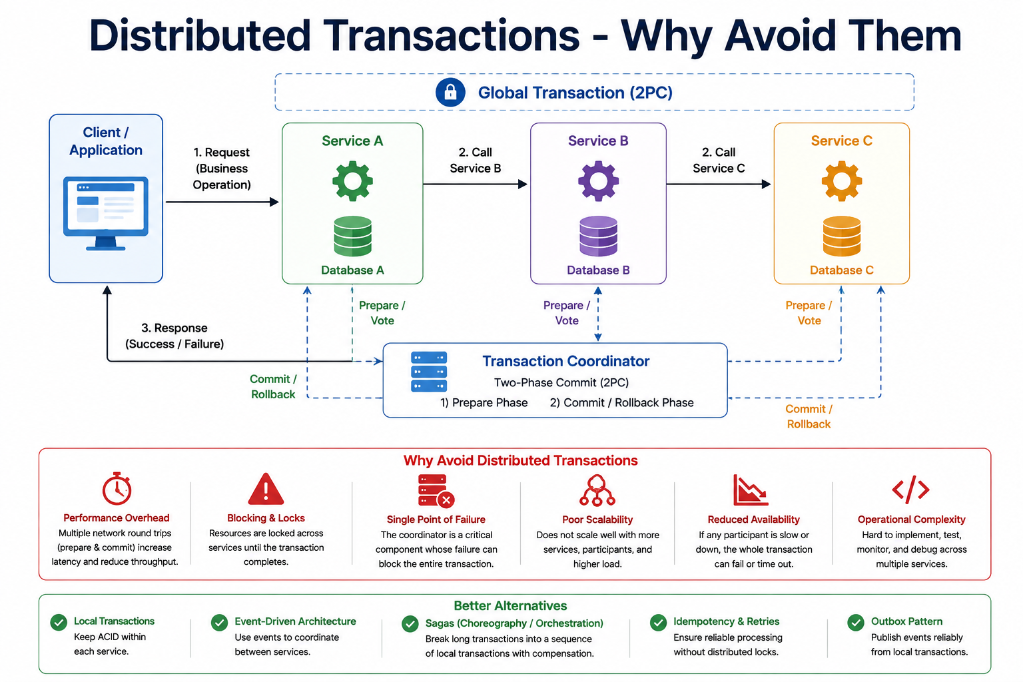
21
© 2026 by Innovation In Software Corporation
Notes:
KEY TALKING POINTS
------------------
- Client and the service chain
The client sends a business operation to Service A. Service A calls Service B and then Service C, synchronously, so each waits for the next to answer.
A response returns only when everything is done.
Each service has its own database, which is correct database-per-service design.
To make it concrete, read Service A as Transaction Service, B as Account Service, and C as Risk Assessment.
Then point out that the capstone does not chain services like this.
The image shows the design being argued against.
- Global Transaction (2PC) and Transaction Coordinator
The dashed banner claims all three databases belong to one global transaction.
The coordinator box at the bottom does the work in two phases.
First, the dashed Prepare/Vote arrows ask every database whether it can commit.
Then the Commit/Rollback arrows deliver the final decision.
Between those phases, every participant holds its locks.
The coordinator is the only component that knows the outcome.
That is where the blocking and single-point-of-failure problems come from.
- Why Avoid Distributed Transactions
Walk the red panel left to right.
Performance overhead comes from extra prepare and commit round trips.
Blocking and locks means resources stay locked until the whole protocol finishes.
The single point of failure is the coordinator.
Poor scalability follows, because every new participant and every extra request adds coordination.
Reduced availability means one slow or unavailable participant fails or times out the whole transaction.
Operational complexity covers implementing, testing, monitoring, and debugging across services.
That includes resolving in-doubt transactions by hand.
- Better Alternatives
The green panel is the design that replaces the top half.
Local transactions keep ACID guarantees, meaning all-or-nothing and durable changes, inside each service.
Event-driven architecture lets services react to events instead of being called in a chain.
Sagas split a long operation into local steps with compensation.
Idempotency and retries make repeated delivery safe without distributed locks.
The outbox pattern publishes events reliably from a local transaction.
Lab 2 already applies four of these ideas.
Only the outbox stays conceptual.
REAL-WORLD EXAMPLES
-------------------
- Many older Java EE banking applications used XA transactions through JTA.
They updated a relational database and an IBM MQ queue together.
It worked.
But after a failure, operations teams sometimes had to resolve in-doubt transactions by hand.
That is the operational complexity box in practice.
- Kafka offers its own transactions for atomic writes across topics.
But it does not act as an XA participant.
That is why Spring and Kafka teams rely on local database transactions, idempotent consumers, and the outbox pattern.
They do not try to include the broker in two-phase commit.
USE-CASE SCENARIO
-----------------
Stage a design review.
A team proposes using a JTA coordinator when creating a capstone transaction.
It would update transaction_db, mark something in account_db, and publish to Kafka atomically.
Walk the red panel with them.
Every POST now waits for two databases and the coordinator.
Account Service rows stay locked during the vote.
And the broker cannot participate at all.
Then redesign with the green panel.
Lab 2 already uses a local transaction in transaction_db and an event on transactions.submitted.
It also has an idempotent consumer backed by processed_events, with two retries before the dead-letter topic.
The outbox is the one remaining gap.
It is exactly what the Lab 2 optional stretch asks learners to sketch.

Slide 23
TWO-PHASE COMMIT AND ITS LIMITATIONS · EVENTUAL CONSISTENCY · SAGA PATTERN OVERVIEW
📌
HOW 2PC WORKS
⚠️
LIMITATIONS
📌
HOW IT WORKS
• Phase 1 (Prepare): coordinator asks all participants if they are ready to commit
• Phase 2 (Commit/Rollback): if all voted yes, coordinator tells everyone to commit; otherwise, rollback
• Blocking protocol: a coordinator failure after Phase 1 leaves participants stuck
• High latency, poor scalability, and not resilient to network partitions
• A write goes to the primary; the update propagates asynchronously to replicas
• For a window of time, different reads may return different values
• After propagation completes, all nodes converge to the same value
✅
KEY CHARACTERISTICS
📌
HOW A SAGA WORKS
✅
BENEFITS
• No immediate consistency, but guaranteed convergence and tolerance for failures
• Trade-off: sacrifices immediate consistency for availability and scalability
• Each service completes its own local transaction, then triggers the next step
• If a step fails, previously completed steps are compensated in reverse order
• Can be implemented via orchestration (central coordinator) or choreography (event-driven)
• No distributed locks or 2PC; better scalability, availability, and fault isolation
KEY TAKEAWAY If the coordinator fails after the prepare phase, every participant blocks indefinitely waiting for a decision that may never come. • Different nodes may briefly disagree after a write, but the system guarantees they converge to the same state once updates stop arriving. • If step three of a saga fails, steps one and two are undone in reverse order through their own compensating actions -- not a database rollback.
22
© 2026 by Innovation In Software Corporation
Notes:
TOPIC 1 OF 3: Two-Phase Commit and Its Limitations
------------------------------------------
KEY TALKING POINTS
------------------
- HOW 2PC WORKS
In the prepare phase, each participant does all the work and writes it durably to its log.
It keeps its locks.
It votes yes only if it can definitely commit later.
Once it has voted yes, it has given up the right to decide alone.
In the commit phase, the coordinator writes its decision.
It tells everyone to commit, or to roll back if any vote was no or missing.
In Java, this is the XA protocol through JTA.
Spring supports it with JtaTransactionManager.
- LIMITATIONS
The weak spot is the gap between the phases.
Suppose the coordinator crashes after participants voted yes.
They are now in doubt: they cannot commit or abort on their own.
So their locks stay held until the coordinator recovers or an operator steps in.
Latency equals the slowest participant plus extra round trips.
Availability shrinks, because every participant must be reachable.
And a network partition, where parts of the network cannot reach each other, leaves some participants unable to learn the decision.
REAL-WORLD EXAMPLES
-------------------
- PostgreSQL supports the participant side of two-phase commit with PREPARE TRANSACTION.
But the max_prepared_transactions setting is zero by default, which disables it.
The documentation warns that a prepared transaction keeps its locks until it is committed or rolled back.
- Enterprise transaction managers in traditional application servers log their decisions.
That lets them finish in-doubt transactions after a restart.
Still, operators in organisations running these stacks keep runbooks.
The runbooks cover resolving stuck transactions by hand when recovery cannot.
USE-CASE SCENARIO
-----------------
Tell it as an incident.
A team has wrapped two changes in one XA transaction: a transaction insert in transaction_db and a related update in account_db.
Both databases vote yes.
Then the coordinator's pod is killed during a node drain.
The account row stays locked, in doubt.
Minutes later, the fraud team tries to freeze that account after a confirmed scam report.
The freeze hangs, waiting for the lock.
No new code bug caused this; the protocol itself did.
Contrast the capstone design.
Transaction Service commits its own row.
Account Service stays free to change status at any time.
And the event flow tolerates either service restarting.
TOPIC 2 OF 3: Eventual Consistency
----------------------------------
KEY TALKING POINTS
------------------
- HOW IT WORKS
The panel describes database replicas, but the same shape applies between services.
Transaction Service commits its write.
The change then travels asynchronously as an event.
For a short window, different parts of the system give different answers.
Transaction Service knows about the transaction, but a consumer has not processed it yet.
Once the event is consumed, every view agrees.
Lab 2 shows this on purpose.
POST returns 201 with RECEIVED, and the guide says to wait two seconds.
GET then shows SUBMITTED.
- KEY CHARACTERISTICS
Convergence is guaranteed only if the plumbing earns it.
That means at-least-once delivery, idempotent consumers, and monitored dead-letter topics.
It also means reconciliation for anything that still slips through.
Without those, eventual becomes never.
The trade is deliberate.
A service that does not wait for every other service stays available when they are down.
It also scales on its own.
But the business must define how much staleness each operation tolerates.
It must also define what the user sees in the meantime.
REAL-WORLD EXAMPLES
-------------------
- Amazon DynamoDB reads are eventually consistent by default.
Applications can request strongly consistent reads when they need them.
The option exists because the eventually consistent read is cheaper and more available.
Many use cases tolerate a brief lag.
- Mobile banking apps commonly show a card purchase as pending before it posts.
The customer sees an in-between state.
The systems converge once the transaction settles.
It is a familiar example of eventual consistency that customers already accept.
USE-CASE SCENARIO
-----------------
Run the Lab 2 flow as a story.
A customer-facing channel posts a transaction.
It immediately receives 201 with status RECEIVED.
The consumer is briefly slow, so a GET a moment later still shows RECEIVED.
A support agent wonders if something is broken.
Nothing is: the system has not converged yet.
Two seconds later, GET shows SUBMITTED.
Now change one thing: the event is malformed.
The consumer retries twice, and the message goes to transactions.submitted.DLT.
That row stays RECEIVED indefinitely.
Convergence depended on someone monitoring the dead-letter topic.
The lab troubleshooting table lists status stuck on RECEIVED for exactly this reason.
TOPIC 3 OF 3: Saga Pattern Overview
-----------------------------------
KEY TALKING POINTS
------------------
- HOW A SAGA WORKS
A saga is a business workflow built from local transactions.
Step one commits in its own service.
Then it signals step two, through an event or a command.
Suppose step three fails.
Its own local transaction has already rolled back.
So only steps one and two need compensation, and they run in reverse order.
Each compensation is a new local transaction that corrects the earlier one.
Coordination comes in two styles.
An orchestrator sends commands and tracks state.
Or, in choreography, services react to each other's events.
- BENEFITS
No service holds a lock while waiting for another.
So a slow or unavailable participant delays its own step instead of freezing the others.
Each service scales and deploys independently.
A failure stays contained to one step, with a defined recovery path.
Be honest about the price.
Someone must design every compensation and track saga state.
Handlers must be idempotent.
And correlation IDs, shared request identifiers, must be carried so the workflow can be traced across services.
REAL-WORLD EXAMPLES
-------------------
- Account opening with initial funding is a natural saga.
Verify the customer, create the account, record the opening deposit, and send the welcome message.
If the deposit fails, the compensation is to close the unfunded account or leave it pending.
Either way, the record is kept for audit.
- Picture an ATM withdrawal that debits the account but then fails to dispense cash.
It is resolved by a reversal posted back to the account.
The original debit is not erased.
A compensating entry restores the balance, and both entries remain on the record.
USE-CASE SCENARIO
-----------------
Place the capstone on a saga map.
Step one is Transaction Service committing a RECEIVED transaction and publishing TransactionSubmitted.
Lab 2 builds that step.
In Lab 5, Risk Assessment Service consumes that event and reaches a decision.
The Lab 2 optional stretch asks learners who would produce a TransactionApproved event.
Ask the room to sketch the unhappy path.
If risk declines the transaction, what does Transaction Service do?
It records the outcome as a new status rather than deleting the row.
Anything already announced gets a correcting message.
That is a choreographed saga with a business-level compensation.
It follows the same no-delete principle Lab 1 applies to closed accounts.

Slide 24
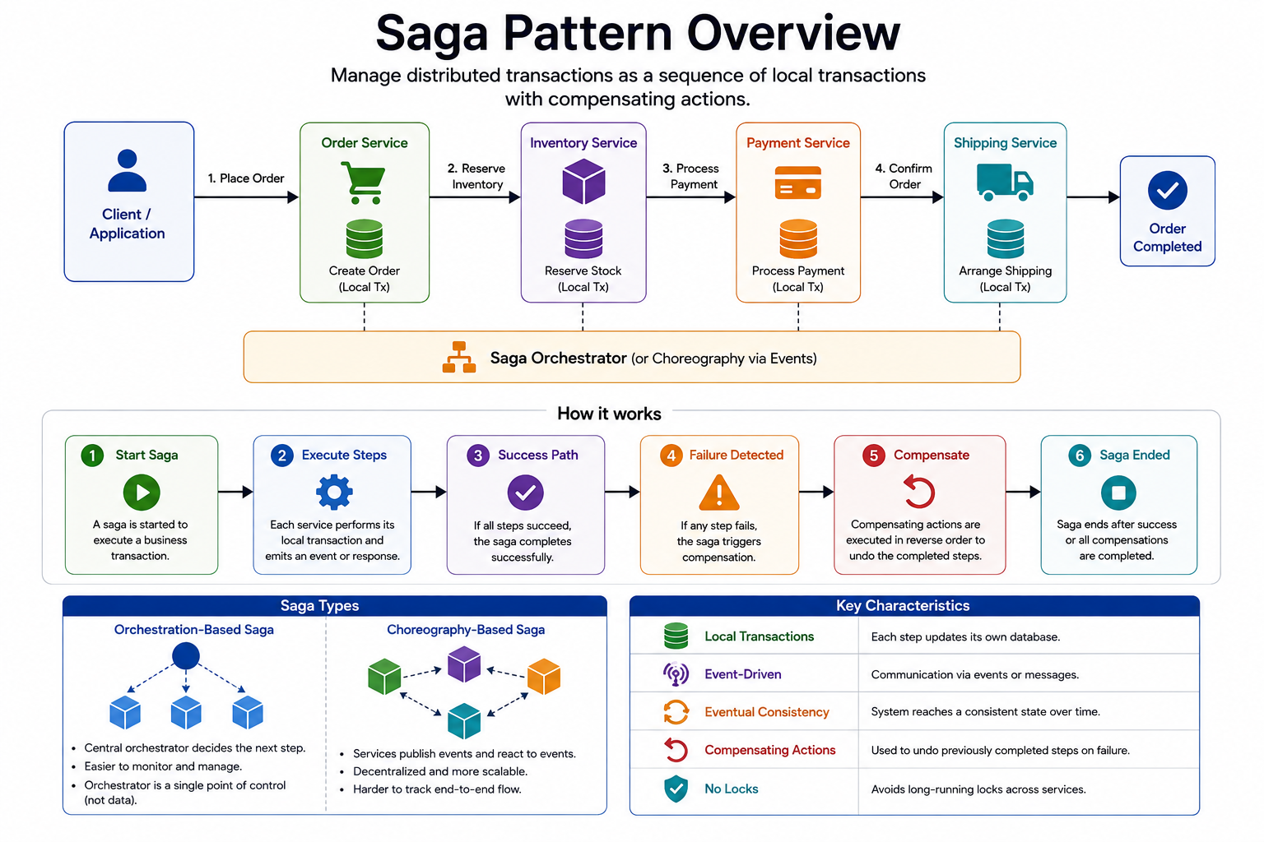
23
© 2026 by Innovation In Software Corporation
Notes:
KEY TALKING POINTS
------------------
- Top flow and Saga Orchestrator
Four services each commit a local transaction in turn.
They create the order, reserve stock, process payment, and arrange shipping.
The orchestrator bar underneath coordinates them.
Its label names choreography via events as the alternative.
Translate it into banking straight away.
A payment to another bank might record the request, place a hold on funds, send the payment, and confirm to the customer.
The shape is identical; only the nouns change.
Each box owns its own database, as the dashed lines to the bar suggest.
- How it works
Read the six stages as a lifecycle.
A saga starts for one business operation.
Each service runs its local step and emits an event or reply.
If everything succeeds, the saga completes.
If any step fails, stage four detects it.
Stage five runs compensating actions in reverse order for the steps that already completed.
Stage six ends the saga either way.
Stress that ended does not always mean succeeded.
A fully compensated saga has also ended correctly.
- Saga Types
The left half shows orchestration.
One central node decides the next step, which is easier to monitor.
The image notes it is a single point of control, not of data.
The right half shows choreography.
Services publish and react to events.
That is more decentralised and scalable, but harder to follow end to end.
Neither is universally better.
Short event chains suit choreography.
Long workflows with many failure branches usually benefit from an orchestrator.
- Key Characteristics
The table names five properties.
Local transactions mean each step updates only its own database.
Event-driven means communication through events or messages.
Eventual consistency means the system reaches a consistent state over time.
Compensating actions undo completed steps on failure.
No locks means no long-running locks across services.
Tie each row back to earlier slides.
Link local transactions to slide 21, eventual consistency to slide 25, and the locking problems of two-phase commit to slide 24.
REAL-WORLD EXAMPLES
-------------------
- Consumer loan origination is a common banking saga.
The application is captured, a credit check is requested, an offer is generated, documents are signed, and funds are disbursed.
If signing never happens, compensation cancels the offer.
It also releases any provisional credit reservation.
Each step belongs to a different system or team.
- An outgoing payment from a mobile app often places a hold on the customer's available balance before the payment is sent.
If sending fails, the compensation releases the hold and notifies the customer.
It does not delete the payment record, which stays for audit.
USE-CASE SCENARIO
-----------------
Redraw the top row for the capstone on a whiteboard.
Box one: Transaction Service commits a RECEIVED transaction and publishes TransactionSubmitted on transactions.submitted, built in Lab 2.
Box two: Risk Assessment Service consumes the event and scores it, arriving in Lab 5.
Box three is a hypothetical future step.
For example, a downstream posting system could record the approved movement.
Now walk stages four and five.
If the posting step fails after approval, the compensation is a status change and a correcting event, not a delete.
Ask learners whether their saga is orchestrated or choreographed.
The capstone's event flow is choreography, because no central component tells the services what to do.

Slide 25
CHOREOGRAPHY-BASED SAGAS · ORCHESTRATION-BASED SAGAS · COMPENSATING TRANSACTIONS
📌
HOW CHOREOGRAPHY WORKS
⚖️
BENEFITS AND CHALLENGES
📌
HOW ORCHESTRATION WORKS
• A service performs a local transaction, then publishes an event describing what happened
• Other services listen for that event and perform their own local transaction and next event
• Decentralized, highly scalable, and loosely coupled -- no single point of failure
• Harder to visualize the full business flow and to trace/debug across many services
• Client requests a business operation; orchestrator starts a saga instance
• Orchestrator sends a command to each participant, records progress, and proceeds
• On failure, the orchestrator triggers compensating transactions in reverse order
⚖️
ADVANTAGES AND CONSIDERATIONS
📌
EXAMPLES OF COMPENSATION
⚠️
CONSIDERATIONS
• Centralized control, visibility, and easier error handling
• The orchestrator becomes a critical component and a potential bottleneck
• Cancel an order, release reserved inventory, refund a payment
• Executed only when a failure occurs, always in reverse order of the completed steps
• Compensation actions must be carefully designed and idempotent
• Not always possible to perfectly undo an action -- the business must tolerate temporary inconsistency
KEY TAKEAWAY TransactionSubmitted is consumed by Transaction Service and later by Risk Assessment -- all without a shared database. • AccountOpeningOrchestrator sends commands to Customer, Account, and Notification services and triggers compensations if any step fails. • Closing an account that was opened but never funded, or reversing a transaction, brings the system to an acceptable state, not a rewritten history.
24
© 2026 by Innovation In Software Corporation
Notes:
TOPIC 1 OF 3: Choreography-Based Sagas
--------------------------------------
KEY TALKING POINTS
------------------
- HOW CHOREOGRAPHY WORKS
Nobody gives orders.
Transaction Service commits its row.
Then it publishes TransactionSubmitted to transactions.submitted.
The event has an envelope, a set of standard wrapper fields: eventType, eventVersion, eventId, correlationId, occurredAt, and a payload.
Any service interested in that fact subscribes and runs its own local transaction.
It may publish a new event, such as a risk decision, for the next participant.
The workflow emerges from who listens to what.
In Lab 2, Transaction Service consumes its own event.
That lets learners practise consuming, duplicates, and the dead-letter topic before Risk Assessment arrives in Lab 5.
- BENEFITS AND CHALLENGES
Adding a consumer requires no change to the publisher.
That is why Risk Assessment can join in Lab 5 without touching Transaction Service's publishing code.
There is no central workflow service to scale or keep available.
The slide's no single point of failure needs a caveat, though.
The Kafka cluster is shared critical infrastructure.
For that reason, it runs highly available on AMQ Streams.
The challenge is visibility, because the business flow lives in subscriptions, not in one file.
Correlation IDs, tracing, and a documented event catalogue are how teams keep it understandable.
REAL-WORLD EXAMPLES
-------------------
- When a card authorization is approved, several bank systems can react to the same authorization event independently.
Fraud monitoring, customer notifications, and rewards tracking each do their own work.
The authorization system does not call any of them.
So a slow rewards system never delays the customer at the checkout.
- A new analytics team that needs payment data can subscribe to existing payment events.
It does not have to ask the payments team to change its code.
That loose coupling is choreography's biggest selling point.
It is also why nobody can see the whole flow unless it is documented.
USE-CASE SCENARIO
-----------------
Two weeks after Lab 2 ships, a customer reports that a transaction never progressed.
With choreography, there is no orchestrator log to open.
The engineer searches the logs for the correlation ID the client sent in X-Correlation-Id.
Lab 2 copies that ID onto the event and into every log line.
So the REST call, the published event, and the consumer's processing all appear together.
The logs show the consumer threw an error on that event.
It retried twice and then sent the event to the dead-letter topic.
Without that correlation ID, the engineer would be reading several services' logs by timestamp and guessing.
Choreography's visibility cost is paid through this kind of discipline.
TOPIC 2 OF 3: Orchestration-Based Sagas
---------------------------------------
KEY TALKING POINTS
------------------
- HOW ORCHESTRATION WORKS
The orchestrator is a component that owns the workflow definition.
It also owns the state of every running instance.
When a request arrives, it creates a saga record.
It sends a command, such as create account, to the first participant.
Then it waits for a reply or a timeout.
It saves each result before sending the next command, so a restart resumes where it stopped.
On failure, it reads which steps completed.
It sends their compensation commands in reverse order.
Participants stay simple.
Each knows how to do its step and how to undo it.
- ADVANTAGES AND CONSIDERATIONS
The whole workflow is readable in one place.
An operator can ask where instance 42 is stuck.
Timeouts, retries, and compensation logic are centralised rather than scattered across event handlers.
Now the costs.
The orchestrator must be highly available and must persist its state.
Every participant change may require an orchestrator change.
The biggest design risk is a god service, one that absorbs business rules that belong in the participants.
Keep the orchestrator focused on sequencing.
It should not decide account eligibility or risk.
REAL-WORLD EXAMPLES
-------------------
- Netflix open-sourced Conductor, a workflow orchestration engine.
Uber built Cadence, and the Temporal project was later forked from it.
Both let teams define long-running workflows centrally, with retries, timeouts, and durable state.
That is orchestration as a platform.
- Banks commonly run loan origination and account opening on workflow or business process engines such as Camunda.
These processes have many human and system steps, regulatory checkpoints, and failure branches.
That is exactly the situation where central visibility pays for itself.
USE-CASE SCENARIO
-----------------
Adapt the subtitle's example to what the capstone actually has.
An account-opening orchestrator receives a request with customerId CUST-0001.
It commands Account Service to create the account, which starts PENDING.
It then asks a funding step to record an opening deposit.
On success, it commands Account Service to activate the account.
If funding fails, it sends the compensation.
That means closing the account through Lab 1's close operation, never a delete.
In a real bank, customer verification and notifications would be separate services.
In this capstone, customerId is simply a field on the account.
No Customer or Notification service exists.
TOPIC 3 OF 3: Compensating Transactions
---------------------------------------
KEY TALKING POINTS
------------------
- EXAMPLES OF COMPENSATION
The panel's examples come from retail, so translate each one.
Cancel an order becomes cancelling a pending payment instruction.
Release reserved inventory becomes releasing a hold on available funds.
Refund a payment becomes posting a reversal entry.
Compensations run only when a later step fails.
They run in reverse order: the most recent completed step is corrected first.
That way each correction sees the state it expects.
The failed step itself needs no compensation, because its local transaction has already rolled back.
- CONSIDERATIONS
Compensations are delivered through the same at-least-once messaging as everything else.
So they may arrive twice.
Releasing a hold twice must not release money twice.
That means compensations must be idempotent, so a repeat has no extra effect.
Key them by an event or saga ID, the way Lab 2's processed_events table works.
Some actions cannot be undone at all.
A sent text message stays sent, so the compensation is a correction message.
Compensations can also fail.
So they need retries, dead-letter handling, and a manual operations queue.
Intermediate states, such as PENDING, should be visible and meaningful to users.
REAL-WORLD EXAMPLES
-------------------
- Card networks support authorization reversals.
When a merchant cancels a sale before settlement, a reversal message releases the hold on the cardholder's funds.
The original authorization stays in the records.
The compensation is its own recorded event.
- Once a wire transfer has been sent, the sending bank usually cannot pull it back on its own.
It has to send a recall request, and the receiving bank may or may not honour it.
This is the real-world version of compensation not always being a perfect undo.
USE-CASE SCENARIO
-----------------
Extend the capstone's unhappy path.
A transaction reaches SUBMITTED.
In a later lab, Risk Assessment declines it, after the customer's channel has already shown it as received.
The team's first idea is to delete the transaction row.
Push back using Lab 1's principle: closed accounts are never physically deleted, because audit needs the record.
The compensation is to record a declined status with a reason and publish a correcting event.
Then any notification sent earlier can be followed by an update.
The decline event could be redelivered.
So the handler first checks an inbox table by eventId, exactly as Lab 2's consumer does.
That way a replay changes nothing.

Slide 26
DATA CONSISTENCY TRADEOFFS · CQRS PATTERN OVERVIEW
📌 CONSISTENCY REQUIREMENTS BY OPERATION
OPERATION | CONSISTENCY NEED
Deduct funds from account | Strong consistency inside the owning service
Send notification | Eventual consistency acceptable
Update reporting dashboard | Eventual consistency acceptable
Validate login | Immediate response required
📌
COMMAND VS. QUERY RESPONSIBILITY SEGREGATION
✅
WHEN CQRS HELPS
• Write side: commands validate business rules and update the source-of-truth data model
• Read side: queries run against a denormalized, purpose-built read model
• The read model is updated asynchronously, typically by consuming domain events
• Reporting and dashboard use cases that would otherwise require expensive cross-service joins
• Read and write workloads that need to scale independently
KEY TAKEAWAY Deducting funds needs strong consistency; updating a reporting dashboard can tolerate eventual consistency -- the business decides which. • Commands update the owning service's write model; queries run against a purpose-built read model kept in sync through events.
25
© 2026 by Innovation In Software Corporation
Notes:
TOPIC 1 OF 2: Data Consistency Tradeoffs
----------------------------------------
KEY TALKING POINTS
------------------
- CONSISTENCY REQUIREMENTS BY OPERATION
Read each row as a business decision.
Deducting funds must be strongly consistent inside the service that owns the balance.
Two concurrent debits must never both pass the balance check.
That calls for a local transaction with locking.
A notification arriving a few seconds late harms nobody.
Neither does a dashboard that lags slightly.
Login validation needs an answer now, while the user waits.
Note that strong consistency is scoped inside one owning service, not across services.
Stress the method.
Classify every operation, write down its tolerated staleness, and then choose the mechanism.
REAL-WORLD EXAMPLES
-------------------
- Banks commonly distinguish available balance from ledger balance.
The available balance must be accurate at the moment a debit is authorised.
End-of-day ledger positions and statements are produced later, sometimes after overnight batch processing.
Customers accept that timing.
- Daily reconciliation between internal ledgers and external payment networks is a standard banking control.
It exists because cross-system consistency is eventual.
Reconciliation is the mechanism that detects and corrects any differences that retries and events did not resolve.
USE-CASE SCENARIO
-----------------
Run a short classification exercise with the capstone.
Checking that an account is ACTIVE before accepting a transaction needs a current answer.
So Transaction Service calls Account Service synchronously over REST.
Moving the transaction from RECEIVED to SUBMITTED through Kafka tolerates a short delay.
That is eventual consistency.
Risk scoring in Lab 5 also runs asynchronously from the event.
Point out that the capstone accounts table has no balance column, so no service deducts funds here.
Validating status is the capstone's strongly consistent check.
Learners should leave able to say, for each capstone call, why it is synchronous or asynchronous.
TOPIC 2 OF 2: CQRS Pattern Overview
-----------------------------------
KEY TALKING POINTS
------------------
- COMMAND VS. QUERY RESPONSIBILITY SEGREGATION
The write model is normalised and guarded by business rules.
In the capstone, that is Transaction Service deciding whether a transaction may be created.
The read model is shaped for one screen or report.
It is often flattened, with data from several sources already combined.
It can be a table in another database, a search index, or a cache.
It is updated by consuming events, so it lags the write side slightly.
It can be rebuilt by replaying events or reloading from the owning services.
Queries never touch the write model's tables.
- WHEN CQRS HELPS
Database per service forbids SQL joins across account_db and transaction_db.
So a report combining both needs somewhere else to live, and a read model is that place.
CQRS, which splits writes from reads, also helps when reads vastly outnumber writes.
It helps when reads need different indexes or storage, too, so each side scales on its own.
It is overkill for simple CRUD, meaning basic create, read, update, and delete.
It adds a second model, event handling, lag, and rebuild procedures.
So reserve it for real reporting or scale problems.
REAL-WORLD EXAMPLES
-------------------
- Online banking transaction search often runs against a search index or reporting store.
That store is filled from posted transactions, not read from the core ledger.
The ledger stays optimised for correct writes.
Customers searching statements do not load the system that posts payments.
- A branch operations dashboard showing account openings and transaction volumes per region is a classic read model.
It is fed by events from several services and refreshed within seconds or minutes.
It is never allowed to write back to the owning systems.
USE-CASE SCENARIO
-----------------
Operations asks for a dashboard showing transactions per account status per hour.
Account status lives in account_db, and transactions live in transaction_db.
Exercise 2.1 is explicit that nobody joins across them.
A reporting service could build a read model.
It would consume TransactionSubmitted for transaction counts, and account status-change events for statuses.
Account Service does not publish events in the labs, so that part would be a future extension.
The dashboard reads one denormalised table that lags reality by seconds.
The business has already classified that as acceptable for reporting.
Neither owning service changes how it writes data.

Slide 27
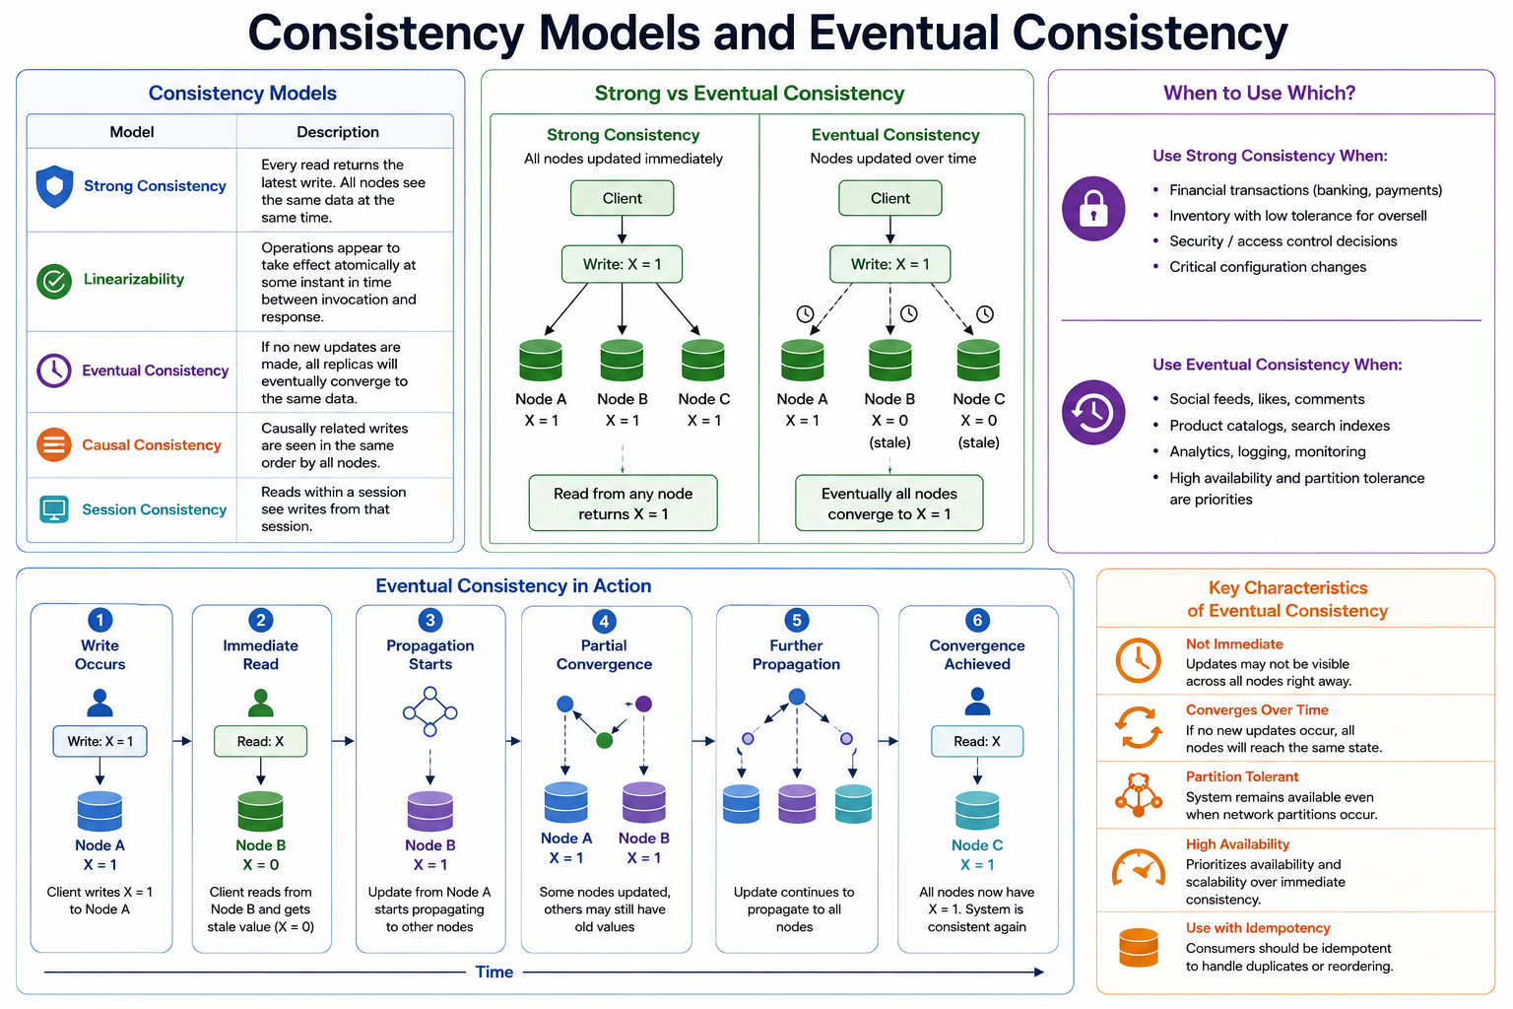
26
© 2026 by Innovation In Software Corporation
Notes:
KEY TALKING POINTS
------------------
- Consistency Models
The table is written about replicas of one data store, but the ideas carry over to services.
Strong consistency means every read sees the latest write.
Linearizability is the formal definition of that guarantee, not a separate practical option.
Eventual consistency means copies converge if updates stop.
Causal consistency keeps cause-and-effect order.
Session consistency guarantees a user sees their own writes.
Read-your-own-writes matters in banking.
A customer who just submitted a transaction must see it.
- Strong vs Eventual Consistency
The left panel shows a write reaching all three nodes before any read.
So every node returns X = 1.
The right panel shows the write landing on Node A first.
Nodes B and C briefly return the old value 0, then converge.
Strong consistency buys correctness, at the cost of waiting for coordination.
Eventual consistency buys availability and independence, at the cost of a short window of stale reads.
- When to Use Which?
The diagram lists financial transactions under strong consistency, which needs nuance.
Inside one service's database, a ledger write is strongly consistent through a local ACID transaction, which commits all or nothing.
Across services, microservices usually accept eventual consistency.
Lab 2 does exactly that.
Social feeds and product catalogs on the eventual side are generic web examples.
The banking equivalents are notifications, reporting dashboards, and analytics.
- Eventual Consistency in Action
The bottom timeline runs left to right.
A client writes to Node A, and a read on Node B returns stale data.
Propagation starts, and some nodes converge.
Propagation continues, and finally all nodes agree.
The practical lesson is that stale reads are a normal, temporary state.
The design must plan for them, with a known window.
It also needs a way to detect when convergence did not happen.
- Key Characteristics of Eventual Consistency
The right panel lists these traits: not immediate, converges over time, partition tolerant, high availability, and use with idempotency.
One wording needs correcting.
Partition tolerance means the system keeps working during network partitions.
What trades away immediate consistency is choosing to stay available, rather than refuse requests, during that partition.
The idempotency point is the bridge to Module 5.
Duplicates and reordering are expected, so consumers must handle them.
REAL-WORLD EXAMPLES
-------------------
- When a card purchase is authorised, the account's available balance updates immediately inside the core system.
The transaction may appear in the mobile app list and in spending insights a little later.
Both behaviours are deliberate choices.
- A bank's reporting dashboard of daily account openings is rebuilt from events.
It may lag the account system by seconds or minutes.
That is acceptable, because no customer decision depends on that number in real time.
USE-CASE SCENARIO
-----------------
Map the diagram onto Lab 2.
A client POSTs a transaction.
Transaction Service writes the RECEIVED row in a local transaction, so that row is strongly consistent within transaction_db.
It publishes TransactionSubmitted, and the consumer marks the row SUBMITTED shortly after.
For that brief window, a GET returns RECEIVED.
That is eventual consistency in action, like the stale Node B read in box 2.
The lab guide says eventual consistency is enough for this step.
It deliberately avoids updating Account Service's database.
In Lab 5, Risk Assessment will consume the same event, and its decision will follow later again.

Slide 28
API COMPOSITION FOR DISTRIBUTED DATA · DATA PRIVACY AND SERVICE BOUNDARIES · DATABASE PERFORMANCE CONSIDERATIONS
📌
HOW IT WORKS
📌
PRIVACY-AWARE DATA DESIGN
• A composition layer calls each owning service for its slice of the data
• Results are merged in application code to build one client-facing response
• Useful for read-heavy views that combine data owned by multiple services
• The owning service controls exactly what fields it exposes through its API
• Downstream services store only the identifiers they need, not full customer records
• Events should avoid carrying sensitive fields unless explicitly required and protected
📌
COMMON PERFORMANCE ISSUES
✅
BEST PRACTICES
• Missing indexes, inefficient queries, and N+1 query problems
• Loading too much data, large response payloads, poor connection pool settings
• Add indexes for common lookup fields (customer email, account number, transaction date)
• Measure before optimizing; use pagination and DTO projections for large or summary result sets
KEY TAKEAWAY A composer calls Customer, Account, and Transaction services in parallel and joins their responses in application code, not in SQL. • No Customer Service in this capstone: Account stores customerId as a field; other services keep only accountId and request data through APIs. • Missing indexes and N+1 queries are the most common root causes of a slow banking API -- and both are fixable before caching is even considered.
27
© 2026 by Innovation In Software Corporation
Notes:
TOPIC 1 OF 3: API Composition for Distributed Data
------------------------------------------
KEY TALKING POINTS
------------------
- HOW IT WORKS
The composer can be an API gateway, a backend-for-frontend built for one client app, or a small dedicated service.
It calls each owner through its public API, ideally in parallel.
Then it joins the responses in memory.
The join happens in Java, not SQL.
Its trade-offs are real.
Total latency is roughly the slowest call.
One unavailable service forces a choice between failing and returning a partial response.
And the pieces are not read at the same instant.
Filtering or paginating across services is hard.
So large cross-service lists usually belong in a CQRS read model instead.
REAL-WORLD EXAMPLES
-------------------
- A mobile banking home screen typically needs profile details, account summaries, and recent activity.
Different systems own each of these.
A backend-for-frontend fetches them in parallel and returns one payload shaped for the phone.
That saves the app several round trips over a mobile network.
- In commercial banking, a relationship manager's client view combines deposits, loans, and card exposure from separate platforms.
Composition keeps each platform the owner of its data.
When one source does not respond, the view shows a clearly labelled unavailable section.
USE-CASE SCENARIO
-----------------
Build an account detail view for the capstone.
A composer calls Account Service on port 8081 at GET /api/v1/accounts/{accountId}.
In parallel, it calls a transaction listing on Transaction Service at port 8082.
Lab 2 only provides GET by transactionId, so that listing would be an extension.
The composer forwards the incoming X-Correlation-Id to both calls, so the logs line up.
Suppose Transaction Service times out.
The composer returns the account with a transactions-unavailable indicator instead of a 500 error.
The product owner makes that decision in advance.
The composer never opens a connection to either database, because both services keep sole ownership of their data.
TOPIC 2 OF 3: Data Privacy and Service Boundaries
------------------------------------------
KEY TALKING POINTS
------------------
- PRIVACY-AWARE DATA DESIGN
Response DTOs, not entities, define the exposed fields.
So a new database column never leaks by accident.
Downstream data is kept to a minimum.
Account Service stores a synthetic customerId such as CUST-0001, not a name or email.
Transaction Service stores only account_id.
Lab 2's TransactionSubmitted payload carries transactionId, accountId, amount, currency, and type, with no personal data.
Events need extra care.
A topic keeps and replicates every message for its retention period, which makes erasure hard.
Logs follow the same rule.
Lab 2's checklist forbids card numbers, emails, and full request bodies.
REAL-WORLD EXAMPLES
-------------------
- Payment systems commonly replace card numbers with tokens.
That way most internal services never see the real number.
Under PCI DSS, this shrinks the set of systems in scope for cardholder-data controls.
It is a privacy benefit and a cost benefit at once.
- Privacy regulations such as the GDPR write data minimisation into law.
That means collecting and keeping only the personal data needed for a purpose.
In microservices, the principle becomes storing identifiers downstream.
Services ask the owning service when more detail is genuinely needed.
USE-CASE SCENARIO
-----------------
During a Lab 2 code review, a learner proposes adding the customer's name and email to TransactionSubmitted.
The goal is to give a future risk model more context.
Walk through the consequences.
That personal data would now be copied into every consumer.
It would be retained on the Kafka topic, and very likely printed in consumer logs.
Then ask what Risk Assessment actually needs to score a transaction.
It needs the accountId, amount, currency, type, and perhaps the account's status or history.
Anything more should come from the owning service through a controlled API call.
There, access can be authorised and audited.
The event stays small, synthetic, and safe to replay.
TOPIC 3 OF 3: Database Performance Considerations
------------------------------------------
KEY TALKING POINTS
------------------
- COMMON PERFORMANCE ISSUES
Missing indexes force PostgreSQL to scan whole tables.
That is invisible with test data and painful with production volumes.
EXPLAIN ANALYZE shows it immediately.
N+1 queries multiply round trips, as the lazy-loading topic showed.
Loading full entities for a summary screen wastes memory and time.
Returning thousands of rows in one response hurts everything at once: the database, the service, the network, and the client.
Pool settings matter too.
Long transactions or an undersized pool make requests queue for connections, even when the database itself is idle.
- BEST PRACTICES
Index the columns that queries actually filter and sort on.
The labs already do this.
Lab 1 indexes customer_id and status on accounts, and Lab 2 indexes account_id and status on transactions.
The slide's customer email and account number are generic examples.
The capstone uses synthetic customerId and accountId values.
Indexes speed up reads but slow down writes.
So add them for real query patterns, through a Flyway migration.
Measure first, with slow-query logs, pg_stat_statements, or Actuator timings.
Then paginate list endpoints with Spring Data's Pageable, and return DTO projections rather than whole entities.
REAL-WORLD EXAMPLES
-------------------
- Transaction history is a classic hot endpoint in online banking.
Paginate it, for example with page and size parameters.
Index account and date together, and return a compact summary DTO.
These steps usually matter more than any cache, because customers mostly look at the most recent page.
- PostgreSQL's pg_stat_statements extension collects execution statistics for each normalised query.
So teams can rank queries by the total time they consume.
Working through that list is a measurement-driven way to decide which index or rewrite to do first.
USE-CASE SCENARIO
-----------------
A teammate extends Transaction Service with a list endpoint: all transactions for an account, newest first.
In testing, it is instant.
With realistic volume, it slows down.
The query filters by account_id but sorts by created_at, and the existing single-column index does not cover the sort.
EXPLAIN ANALYZE shows the sort step.
The team adds V2__idx_transactions_account_created.sql with a composite index on account_id and created_at.
They switch the method to take a Pageable and return a slim DTO.
Only after measuring again do they discuss caching.
Redis stays lecture-only for this course.
The fix came from query design, not from infrastructure.

Slide 29
DATA PERSISTENCE ANTI-PATTERNS · CACHING FUNDAMENTALS · WHEN CACHING HELPS-AND WHEN IT DOES NOT
❌
ANTI-PATTERNS TO AVOID
📌
WHAT A CACHE STRATEGY MUST DEFINE
• Returning JPA entities directly from APIs instead of DTOs
• Sharing a database across services; using ddl-auto: update in production
• Ignoring lazy loading behavior and eager-loading everywhere
• Creating extremely large, deeply nested entity graphs
• What data is cached and where it is cached (local vs. distributed)
• How long it lives (TTL) and when it is invalidated
• What happens to the application when the cache is unavailable
✅
GOOD CANDIDATES
❌
POOR CANDIDATES
• Frequently read data that is expensive to compute or changes infrequently
• Reference data and aggregated read models
• Highly sensitive data, rapidly changing balances
• Data requiring immediate accuracy, large unbounded result sets
KEY TAKEAWAY Returning JPA entities directly, sharing databases, and skipping migrations are small shortcuts with outsized long-term cost. • What to cache, where, for how long, and how to invalidate it are all design decisions, not defaults to accept blindly. • Account balances and fraud scores are poor caching candidates; reference data and product configuration are excellent ones.
28
© 2026 by Innovation In Software Corporation
Notes:
TOPIC 1 OF 3: Data Persistence Anti-Patterns
------------------------------------------
KEY TALKING POINTS
------------------
- ANTI-PATTERNS TO AVOID
Returning entities ties your public JSON contract to your table layout.
It can leak internal columns.
It can also cause lazy-loading exceptions during serialization, when the object is turned into JSON.
That is why the labs return response DTOs, which are simple objects built for the API.
Sharing a database brings the monolith back through the back door.
And ddl-auto: update lets Hibernate change the production schema with no review.
Lab 2 uses Flyway plus ddl-auto: validate instead.
Eager loading everywhere pulls whole object graphs for a simple lookup.
Deep graphs cause N+1 queries and recursive JSON.
Keep entities flat, and refer to other services by ID.
REAL-WORLD EXAMPLES
-------------------
- Picture a card-servicing API that returns its Card entity directly.
Someone adds internal columns, such as risk flags or audit fields, to the table.
Those columns show up in the API at once, because the JSON contract silently follows the schema.
- Some teams let Hibernate auto-update production schemas.
They often find a renamed field became a new empty column, while the old data stayed behind.
That is exactly the drift that versioned Flyway migrations and schema validation prevent.
USE-CASE SCENARIO
-----------------
In the capstone, imagine Transaction Service had a JPA @ManyToOne link from Transaction to the Account entity, pointing at account_db.
Every GET of a transaction would reach into another team's database.
The Account team could not rename a column without breaking Transaction Service.
Returning that entity as JSON would dump account internals into a transaction response.
Lab 2 avoids all of it.
The transactions table stores account_id as a plain string.
The API returns a TransactionResponse DTO.
Flyway V1 creates the schema.
And ddl-auto: validate fails startup if the entity and the table disagree.
TOPIC 2 OF 3: Caching Fundamentals
----------------------------------
KEY TALKING POINTS
------------------
- WHAT A CACHE STRATEGY MUST DEFINE
Start with what and where.
A local in-memory cache is fastest, but each pod holds its own copy.
A distributed cache such as Redis is shared across pods, but it adds a network hop.
Next comes how long and when invalidated.
TTL, or time to live, limits how stale data can get.
Eviction on write removes entries you know are stale.
Last comes unavailability.
Decide in advance whether the service falls back to the database, degrades gracefully, or fails.
A cache outage should slow the service down.
It should not take it down or return wrong answers.
REAL-WORLD EXAMPLES
-------------------
- A bank's branch and ATM locator reads the same location list constantly, and the list changes rarely.
So a distributed cache with a TTL measured in minutes works well.
If the cache goes down, it simply falls back to the database.
- Exchange-rate lookups for a payments screen are cached briefly, with a short TTL.
Showing a rate a few minutes old for display is acceptable.
Using that old rate to settle a payment is not.
USE-CASE SCENARIO
-----------------
Suppose a later team wants to cache account status in front of Account Service, so Transaction Service can validate faster.
Before writing @Cacheable, they must answer the four questions.
Where?
A shared cache, since Transaction Service runs several pods on OpenShift.
How long?
Very short, because a frozen account must stop transacting quickly.
Invalidation?
Account Service must evict the entry when it freezes or closes an account.
Outage?
Fall back to the live REST GET.
Walking through this shows the room why Lab 2 skips the cache entirely.
It always asks Account Service directly.
TOPIC 3 OF 3: When Caching Helps-and When It Does Not
------------------------------------------
KEY TALKING POINTS
------------------
- GOOD CANDIDATES
Caching pays off when many reads hit the same value and a slightly old copy is harmless.
Reference data changes rarely and is read constantly.
Examples are currency codes, branch lists, and product definitions.
Aggregated read models are expensive to compute.
A monthly spending summary built from many rows is one example.
Caching the finished result saves real database work.
The test is simple.
Multiply read frequency by recompute cost, then weigh that against the business cost of a stale answer.
- POOR CANDIDATES
Sensitive data in a cache is another copy to secure, encrypt, and audit.
That copy often has weaker controls than the database.
Balances change with every posting.
So a cached balance is wrong exactly when a customer is watching it.
Anything used for an authorization or risk decision needs the current value.
Large unbounded result sets, such as full transaction history, waste memory.
They are also rarely requested twice with the same parameters.
Paginate and index those instead of caching them.
REAL-WORLD EXAMPLES
-------------------
- A card product catalog lists rewards tiers and annual fees, and it is ideal for caching.
It gets thousands of reads per minute.
It is updated only when marketing publishes a change.
A brief delay in showing a new tier harms nobody.
- An available-balance check before a debit card authorization must read the authoritative ledger.
Approving a purchase against a cached balance from a minute ago is how an account ends up overdrawn.
USE-CASE SCENARIO
-----------------
Take the capstone's three services.
Risk Assessment Service, added in Lab 5, might reasonably cache static reference data.
Examples are a list of supported currencies or merchant category descriptions.
It should not cache a risk score for a transaction and reuse it.
Each new transaction changes the picture.
Transaction Service should never cache an account's eligibility for long.
Account Service can freeze an account at any moment.
Ask the room to classify each item.
Have them justify each choice with the good and poor lists on this slide.

Slide 30
CACHE-ASIDE PATTERN · READ-THROUGH AND WRITE-THROUGH CACHING · WRITE-BEHIND CACHING
📌
CACHE-ASIDE FLOW
📌
READ-THROUGH
1. Application checks the cache for the requested key
2. If found, return the cached value directly
3. If not found, query the database, store the result in the cache, then return it
• On a cache miss, the cache itself loads the value from the database and stores it
• Application code always talks to the cache, never directly to the database for reads
✅
WRITE-THROUGH
📌
HOW WRITE-BEHIND WORKS
• Writes go to the cache first, which synchronously writes through to the database
• Keeps cache and database aligned, at the cost of added write latency
• Write goes to the cache, which returns immediately
• The cache asynchronously flushes the write to the database, often batched
• Improves write latency and throughput, but risks data loss if the cache fails before flushing
KEY TAKEAWAY @Cacheable implements cache-aside out of the box -- the application, not the cache, owns the responsibility of keeping data fresh. • Instead of the app deciding when to populate the cache, the caching layer itself loads on a miss and writes through on every update. • Fast writes come at the cost of a short window where cache and database can disagree if the service fails before the write flushes.
29
© 2026 by Innovation In Software Corporation
Notes:
TOPIC 1 OF 3: Cache-Aside Pattern
---------------------------------
KEY TALKING POINTS
------------------
- CACHE-ASIDE FLOW
The application sits in the middle.
On a hit, it skips the database entirely.
On a miss, it loads from the database and writes the result into the cache for next time.
The cache only holds data someone actually asked for, which keeps memory focused.
There are costs.
The first request after a miss or eviction is slow.
And nothing updates the cache when data changes, unless the application evicts the entry.
@Cacheable wraps a method with exactly this check, load, and store logic.
REAL-WORLD EXAMPLES
-------------------
- A mobile banking app's product-details screen calls a service method annotated with @Cacheable.
The first customer to open a product page triggers a database query.
Later customers get the cached copy until it expires.
- Online retail and streaming platforms often put cache-aside in front of catalog or metadata lookups.
The pattern is simple, and the database stays authoritative.
If the cache fails, the system just falls back to slower database reads.
USE-CASE SCENARIO
-----------------
Picture a lecture-only extension where Account Service caches its GET /api/v1/accounts/{accountId} response.
The first call from Transaction Service misses.
It reads account_db, stores the DTO, and returns ACTIVE.
The next calls are hits.
Then an operator freezes the account.
With plain cache-aside and no eviction, Transaction Service keeps seeing ACTIVE until the TTL expires.
It could accept a transaction that Lab 2 would reject with 409 ACCOUNT_NOT_ELIGIBLE.
This is why the freeze path would need an eviction.
It is also why the lab calls the live service instead.
TOPIC 2 OF 3: Read-Through and Write-Through Caching
------------------------------------------
KEY TALKING POINTS
------------------
- READ-THROUGH
The difference from cache-aside is who loads the data on a miss.
In read-through, the cache is set up with a loader.
The application just asks the cache, and the cache fetches from the database when needed.
Application code gets simpler, and loading logic lives in one place.
In practice, this comes from the cache product or a library-level loading cache.
Plain Redis does not do it by itself.
Many teams say @Cacheable feels like read-through.
But the loading still happens in your method.
- WRITE-THROUGH
Every write goes to the cache.
The cache writes to the database before returning, so a successful write means both copies match.
The trade-off is latency, because each write now updates two stores.
The cache layer also needs its own database access and error handling.
Write-through suits data that is read far more than written.
It also suits data that must never be stale right after a change.
It is more common with dedicated data-grid products than with a simple Redis cache.
REAL-WORLD EXAMPLES
-------------------
- Some banks use enterprise in-memory data grids for session or reference data.
These grids are set up with loader and writer plugins.
Applications read and write the grid, and the grid keeps its backing database aligned.
- Picture a product-pricing store where marketing updates rates a few times a day.
Web channels read those rates constantly.
The store can use write-through, so the next read after an update is guaranteed fresh.
USE-CASE SCENARIO
-----------------
Explain it with the capstone team's future reference data.
Say Risk Assessment Service kept a table of merchant category codes.
A read-through cache would let every scoring call ask the cache for a code description.
The cache would load any missing code from the database.
Now say the compliance team updated a category.
A write-through cache would push the change to the database and hold the new value in one step.
The team would accept slightly slower updates, which happen rarely.
In exchange, they would never score against an outdated description.
TOPIC 3 OF 3: Write-Behind Caching
----------------------------------
KEY TALKING POINTS
------------------
- HOW WRITE-BEHIND WORKS
The application treats the cache as the write target.
It gets an instant acknowledgement and moves on.
A background process gathers pending writes and applies them to the database.
Sometimes it combines many writes into one batch.
This suits high-volume data where some loss is tolerable, such as counters or telemetry.
For anything with money or legal meaning, it is dangerous.
A crash between acknowledgement and flush loses writes the caller believes were saved.
In banking, the system of record must receive the write before success is reported.
REAL-WORLD EXAMPLES
-------------------
- Page-view or click counters for a bank's marketing site can be incremented in memory and flushed in batches.
Losing a few increments in a crash has no customer or regulatory impact.
- A payment instruction must never use write-behind.
Picture telling a customer a transfer was accepted, then losing it because a cache node restarted before flushing.
That would be a customer-facing failure and an audit failure.
USE-CASE SCENARIO
-----------------
Ask the room to imagine speeding up Lab 2 with a cache.
New transactions go to the cache and flush to transaction_db every few seconds.
The POST would return 201 faster.
But if the pod restarted before the flush, the customer would hold a transactionId that exists nowhere.
A TransactionSubmitted event might already be on Kafka for a row that never landed.
Lab 2 instead saves the row in PostgreSQL inside a local transaction before anything else happens.
That contrast makes the risk of write-behind concrete.

Slide 31
REDIS ARCHITECTURE AND DATA STRUCTURES · SPRING CACHE ABSTRACTION · INTEGRATING REDIS WITH SPRING BOOT
📌
REDIS DATA STRUCTURES
📌
CORE CACHING ANNOTATIONS
• Strings and hashes: common for basic caching of values and objects
• Lists, sets, and sorted sets: queues, uniqueness checks, and leaderboards
• Streams: lightweight event/message logs
• @Cacheable: cache the method's return value, keyed by its arguments
• @CachePut: always run the method and update the cache with the result
• @CacheEvict: remove an entry (or clear a cache) when data changes
📌
TYPICAL SETUP
⚠️
IMPORTANT CAUTION
• spring.data.redis.host / port configuration in application.yml
• @EnableCaching on the application class activates Spring's cache abstraction
• @Cacheable(value = "customers", key = "#id") caches a repository lookup method
• Redis should not casually become the system of record for critical banking data
• The relational database remains the source of truth; Redis acts as a cache
KEY TAKEAWAY Strings, hashes, lists, sets, sorted sets, and streams give Redis far more flexibility than a plain cache -- rate limiting, queues, and counters included. • @Cacheable, @CachePut, and @CacheEvict express caching intent declaratively -- the actual cache backend is a configuration decision. • Lecture only — Labs 1-5 do not install Redis (PostgreSQL is the store). spring.data.redis.host/port plus @Cacheable is enough to cache a lookup method.
30
© 2026 by Innovation In Software Corporation
Notes:
TOPIC 1 OF 3: Redis Architecture and Data Structures
------------------------------------------
KEY TALKING POINTS
------------------
- REDIS DATA STRUCTURES
Strings hold a serialized value, such as a JSON DTO.
Hashes hold field-value pairs, so you can read or update one field without rewriting the whole object.
Lists work as simple queues.
Sets answer 'have we seen this before'.
Sorted sets keep members ordered by a score, which is useful for rankings or time windows.
Streams are append-only logs with consumer groups.
Redis streams are handy for small jobs.
But in this course the event backbone is Kafka on Red Hat AMQ Streams, not Redis.
REAL-WORLD EXAMPLES
-------------------
- An API gateway rate limiter can keep a per-client counter in a Redis string with an expiry.
Once the counter passes the allowed calls for that time window, it rejects requests.
- A fraud team can use a Redis sorted set scored by timestamp.
It counts how many card attempts a device made in the last few minutes.
Old entries are trimmed as the window moves.
USE-CASE SCENARIO
-----------------
Describe how a bank might use several Redis structures around the capstone without making Redis a system of record.
A hash could hold a cached account-status DTO.
A set could remember recently seen correlation IDs for quick diagnostics.
A sorted set could track recent transaction attempts per account.
That would feed a velocity rule in Risk Assessment Service.
In every case, PostgreSQL and Kafka stay authoritative.
Redis only speeds up reads or short-lived checks.
Then remind the room that none of this is built in Labs 1 to 5.
TOPIC 2 OF 3: Spring Cache Abstraction
--------------------------------------
KEY TALKING POINTS
------------------
- CORE CACHING ANNOTATIONS
@Cacheable is the read side.
On a hit, the method body never runs.
@CachePut is for write methods that return the updated object, so the cache gets the new value.
@CacheEvict is for writes where it is simpler to drop the entry.
The next read then reloads it.
Setting allEntries = true clears a whole cache.
These annotations work through Spring proxies, which are wrappers around your bean.
So calling an annotated method from another method in the same class skips the cache.
That is a common surprise when caching seems not to work.
REAL-WORLD EXAMPLES
-------------------
- A customer-profile service can put @Cacheable on getProfile.
It can put @CachePut on updateProfile, so the refreshed profile is cached immediately.
And it can put @CacheEvict on a delete-style closure method.
- Teams often develop against a simple in-memory cache.
They switch to Redis in shared environments by changing only dependencies and configuration.
The annotated service code does not change at all.
USE-CASE SCENARIO
-----------------
Walk through a lecture-only version of Account Service.
GET account by ID gets @Cacheable, with the accountId as the key.
The activate, freeze, and close methods from Lab 1 each get @CacheEvict for the same key.
So the next GET reloads the new status.
Someone proposes @CachePut on update nickname, because it returns the updated DTO.
That works too.
Then ask what happens if freeze forgets its @CacheEvict.
Transaction Service could see a frozen account as ACTIVE.
The annotation pairing is the real design work.
TOPIC 3 OF 3: Integrating Redis with Spring Boot
------------------------------------------
KEY TALKING POINTS
------------------
- TYPICAL SETUP
With the Redis starter on the classpath, Spring Boot sets up a connection from spring.data.redis.host and port.
In Spring Boot 3 the prefix is spring.data.redis, not the older spring.redis.
@EnableCaching turns on annotation processing.
Spring Boot then provides a Redis-backed cache manager.
You can set a global TTL with spring.cache.redis.time-to-live.
One caution on the slide example.
Cache the service method that returns a DTO, not a repository method that returns an entity.
That matches the later guidance to cache DTOs, not entity graphs.
- IMPORTANT CAUTION
Redis keeps data in memory.
It can have persistence options turned on.
Even so, it is not built to give the transactional guarantees, constraints, and audit history a ledger needs.
Suppose Redis becomes the only copy of important data.
A restart could lose it.
So could eviction under memory pressure, or a failover.
The rule for this course is clear.
PostgreSQL owns the truth, and each service owns its own database.
Redis, when used, only holds copies that can be rebuilt from that truth.
REAL-WORLD EXAMPLES
-------------------
- Teams upgrading from Spring Boot 2 to 3 often find their Redis connection silently falling back to localhost.
The cause is configuration that still uses the old spring.redis prefix instead of spring.data.redis.
- Banks commonly use Redis for session data and short-lived tokens that can be reissued.
They keep balances, payments, and customer records in relational systems with backups and audit trails.
USE-CASE SCENARIO
-----------------
A developer on the capstone team suggests storing transaction status in Redis.
The consumer updates it, and reads would be faster.
Walk the room through the caution panel.
Transaction status is business data that auditors may query.
The SUBMITTED update must be tied to the processed_events record in one local transaction for idempotency, meaning a repeated event is safely ignored.
A Redis eviction could make a transaction disappear.
The correct answer is what Lab 2 does.
Status lives in transaction_db and is updated inside a @Transactional consumer.
Any cache would be a rebuildable copy.

Slide 32
CACHE KEYS AND VALUE DESIGN · CACHE EXPIRATION AND TIME-TO-LIVE · CACHE INVALIDATION STRATEGIES
📌
CACHE KEY DESIGN PRINCIPLES
📌
MATCHING TTL TO DATA
📌
INVALIDATION TRIGGERS
• Namespace keys by service and entity type, e.g. customer:101:profile
• Keep values small and focused -- cache DTOs or summaries, not full entity graphs
• Use consistent, meaningful key patterns so keys can be found, scanned, or bulk-invalidated
• Account status: short TTL
• Customer profile: moderate TTL
• Product configuration: longer TTL
• Fraud risk score: very short TTL
• Time-to-live expired
• Underlying data was updated (evict via @CacheEvict on the write path)
• Memory limit reached, or manual invalidation was triggered
KEY TAKEAWAY customer:101:profile beats a bare 101 -- namespacing prevents key collisions and makes bulk invalidation by prefix possible. • Account status needs a short TTL, fraud risk score needs a very short TTL, and product configuration can tolerate a much longer one. • When a customer updates their phone number, the write must update the database and evict or refresh the cached profile in the same operation.
31
© 2026 by Innovation In Software Corporation
Notes:
TOPIC 1 OF 3: Cache Keys and Value Design
-----------------------------------------
KEY TALKING POINTS
------------------
- CACHE KEY DESIGN PRINCIPLES
A shared Redis may serve several services, so a key like 101 could mean a customer, an account, or a branch.
Adding the entity and purpose as a prefix makes keys unambiguous.
It also lets operations find or clear one family of keys by prefix.
Small DTO values serialize quickly and use less memory.
They also do not break when an entity gains a lazy relationship.
Consistent patterns help security reviews too, because it is obvious which keys might hold sensitive fields.
Spring's cache name plus key already gives a basic namespace.
REAL-WORLD EXAMPLES
-------------------
- Two teams shared one Redis cluster, and both cached records under plain numeric IDs.
One team's account summary started appearing where the other expected a customer profile.
Adding service and entity prefixes fixed the collision.
- An operations runbook might say to clear all keys matching account-status for one account after a data fix.
That only works if every service wrote those keys with the same agreed pattern.
USE-CASE SCENARIO
-----------------
Use the capstone's synthetic IDs.
Account Service uses IDs like ACC- plus 8 hex characters.
Transaction Service uses TXN- plus 8 hex.
If both cached into one Redis with bare IDs, collisions are unlikely thanks to the prefixes.
But a reference-data cache keyed only by a currency code such as USD could clash with another team's key.
A key pattern such as account-service:account:ACC-1A2B3C4D:status leaves no ambiguity.
The value would be a small status DTO with accountId and status.
It would not be the full accounts row with customer_id and timestamps.
TOPIC 2 OF 3: Cache Expiration and Time-to-Live
------------------------------------------
KEY TALKING POINTS
------------------
- MATCHING TTL TO DATA
Account status gets a short TTL, because a freeze or closure must take effect quickly.
A customer profile changes now and then.
A slightly old mailing address on a display screen is tolerable, so a moderate TTL works.
Product configuration changes on a release schedule, so a longer TTL is fine.
A fraud risk score reflects fast-changing behaviour.
So it should live very briefly, if it is cached at all.
TTL is a safety net.
You still need explicit eviction on write when accuracy matters.
REAL-WORLD EXAMPLES
-------------------
- A retail bank's savings product page can cache interest-rate display content for a longer period.
It refreshes the content when a rate change is published.
The rate change goes through a scheduled approval process anyway.
- Picture a card-controls feature where a customer locks their card.
The lock must take effect on the next authorization.
So any cached lock state needs a very short TTL, plus immediate eviction when the customer toggles it.
USE-CASE SCENARIO
-----------------
Ask the room to set TTLs for a lecture-only cache in front of the capstone.
First, account status read by Transaction Service.
Make it short, measured in seconds, plus eviction on freeze.
Next, the supported currency list used for validation, which Lab 2 limits to USD.
Make it long, since it changes only with a release.
Last, Risk Assessment's score for a transaction from Lab 5 gets effectively no cache time, because each transaction is scored on its own facts.
Have them justify each number.
They should describe the business harm if the value were stale for that long.
TOPIC 3 OF 3: Cache Invalidation Strategies
------------------------------------------
KEY TALKING POINTS
------------------
- INVALIDATION TRIGGERS
TTL expiry is passive, and it guarantees an upper bound on staleness.
Eviction on update is active.
Every method that changes the data must remove or refresh the cached copy.
That is why @CacheEvict sits on the write path.
Memory limits trigger eviction policies, such as removing the least recently used keys.
So a cache entry can vanish at any time, and code must handle misses.
Manual invalidation is the operations tool after a data correction or a bad deployment.
Well-designed systems combine TTL with active eviction.
REAL-WORLD EXAMPLES
-------------------
- A customer updates their mobile number for one-time passcodes.
If the profile cache is not evicted, the next login code goes to the old number.
That is both a service problem and a security problem.
- A batch job corrects a set of mis-coded merchant categories.
Afterwards, an operator manually clears the category cache.
Every service then reloads the corrected values instead of waiting for TTL.
USE-CASE SCENARIO
-----------------
Tie it to Lab 1's account lifecycle.
Picture a lecture-only cached Account Service.
The account-status entry needs eviction on activate, freeze, and close, the three state-changing POST endpoints.
Suppose someone later adds a new state-changing endpoint and forgets @CacheEvict.
Ask the room which trigger protects them.
The answer is only TTL.
Next, a support engineer fixes a status directly in the database during an incident.
Ask which trigger they use.
The answer is manual invalidation.
And remind them that memory eviction means Transaction Service must always cope with a miss by calling the live API.

Slide 33
PREVENTING STALE DATA · CACHE STAMPEDE AND PENETRATION
📌
PREVENTING STALE DATA
📌
TWO RELATED FAILURE MODES
✅
MITIGATIONS
• Evict or update the cache in the same transaction or operation as the database write
• Use short TTLs for data where staleness has real business consequences
• Never cache highly volatile data (account balances) without an explicit invalidation path
• Cache stampede: a hot key expires and many concurrent requests all recompute it at once
• Cache penetration: repeated requests for a nonexistent key never get cached, always hitting the database
• Locking or request coalescing on cache-miss recomputation
• Cache negative results briefly, or use a bloom filter to short-circuit lookups for known-missing keys
KEY TAKEAWAY Pairing every cache-populating read with a cache-evicting write is the single most important discipline in cache design. • Cache penetration is the related risk of repeated lookups for keys that don't exist at all, bypassing the cache on every single request.
32
© 2026 by Innovation In Software Corporation
Notes:
TOPIC 1 OF 2: Preventing Stale Data
-----------------------------------
KEY TALKING POINTS
------------------
- PREVENTING STALE DATA
Every place that fills the cache needs a matching place that clears it when the data changes.
One correction to the first bullet.
Redis does not join the PostgreSQL transaction, so the two cannot commit atomically, as one unit.
The safe practice is to evict after the database commit succeeds.
Use a transaction-aware cache manager or an after-commit hook.
Keep a short TTL as a backstop.
For balances, an explicit invalidation path means every posting evicts.
Otherwise, you simply do not cache them.
REAL-WORLD EXAMPLES
-------------------
- A customer moves money between their own accounts and refreshes the app.
But a dashboard cache without eviction on transfer still shows the old totals.
This is a leading source of support calls in digital banking.
- A bank caches credit-limit display values.
It evicts that entry whenever an underwriter changes the limit.
It still sets a short TTL, in case a batch process updates limits directly.
USE-CASE SCENARIO
-----------------
Imagine a customer dashboard read model built on top of the capstone.
It caches a summary of recent transactions per account.
When Transaction Service's consumer marks a transaction SUBMITTED, the dashboard must evict that account's summary.
Otherwise, the customer sees the transaction stuck as RECEIVED.
Now suppose the eviction ran before the transaction_db commit.
A concurrent read could re-cache the old RECEIVED state just before the commit lands.
Evicting after commit, with a short TTL as backup, prevents that race.
The pairing rule becomes a checklist item in code review.
TOPIC 2 OF 2: Cache Stampede and Penetration
------------------------------------------
KEY TALKING POINTS
------------------
- TWO RELATED FAILURE MODES
Both failures send load straight past the cache to the database.
In a stampede, the key is valuable and popular.
One expiry turns thousands of cheap cache hits into thousands of identical expensive queries in the same second.
That can overload the database.
Penetration involves keys that will never exist, such as random or malformed IDs.
A plain cache-aside setup does not store 'not found', so every request queries the database.
Penetration is sometimes deliberate probing, which makes it a security concern too.
- MITIGATIONS
For stampedes, let only one caller rebuild the value.
Others wait or receive the old value.
In Spring, @Cacheable(sync = true) does this within one application instance.
Across many pods, you need a distributed lock.
Or you use staggered, randomized TTLs so hot keys do not expire together.
For penetration, cache a not-found marker for a short time.
You can also validate IDs before lookup.
Or use a bloom filter, a compact structure that cheaply answers 'definitely does not exist'.
Keep negative entries brief, so newly created records appear quickly.
REAL-WORLD EXAMPLES
-------------------
- A popular rates or offers page may have cached content that expires at the top of the hour.
Every web server can then fire a burst of identical database queries at once.
Staggered expiry avoids the spike.
- Automated scripts may probe an account-lookup endpoint with random account numbers.
Each request bypasses the cache.
Input validation, plus brief caching of not-found results, keeps that load off the database.
USE-CASE SCENARIO
-----------------
Point to Lab 2's input validation as a penetration defence the class will actually build.
CreateTransactionRequest requires accountId to match ACC- followed by 8 hex characters.
So malformed IDs get 400 before any call to Account Service.
A well-formed ID for a missing account still reaches Account Service, which returns 404, and Transaction Service then returns 409 ACCOUNT_NOT_ELIGIBLE.
Now picture a lecture-only cached design.
A short negative cache entry for that missing ID would stop a script from hitting account_db repeatedly.
Stampede protection would matter if many pods cached one popular reference value.

Slide 34
DISTRIBUTED CACHING CONSIDERATIONS · REDIS HIGH AVAILABILITY · SECURING REDIS
📌
KEY CONSIDERATIONS
📌
HIGH AVAILABILITY OPTIONS
🔒
SECURING REDIS
• Partitioning/sharding strategy across the cluster as data volume grows
• Consistent key design across every service instance sharing the cache
• Defined fallback behavior for the application when the cache cluster is unavailable
• Primary-replica replication for read scaling and failover
• Redis Sentinel for automatic failover and monitoring
• Redis Cluster for sharded, horizontally scaled deployments
• Require authentication (requirepass or Redis ACLs) -- never run open
• Restrict network access to only the services that need it
• Enable TLS for data in transit, and avoid caching sensitive data unless explicitly protected
KEY TAKEAWAY Multiple service instances sharing one Redis cluster must agree on key design, eviction policy, and what happens if the cluster is unreachable. • A single Redis instance is a single point of failure -- replication with automatic failover is what makes caching production-safe. • Authentication, network isolation, and TLS are not optional extras for Redis in a banking platform -- they're baseline requirements.
33
© 2026 by Innovation In Software Corporation
Notes:
TOPIC 1 OF 3: Distributed Caching Considerations
------------------------------------------
KEY TALKING POINTS
------------------
- KEY CONSIDERATIONS
Partitioning spreads keys across nodes, so memory and throughput can grow.
But multi-key operations then only work when the keys land on the same partition.
Consistent key design matters because pod 1 and pod 5 of the same service must write and evict identical keys.
Other services may share them too.
If the keys differ, evictions miss.
Fallback behaviour means timeouts on cache calls and a clear rule.
Either go to the database or degrade features.
Without a short timeout, a slow cache makes every request slow.
REAL-WORLD EXAMPLES
-------------------
- An online banking web tier runs many instances behind a load balancer.
It needs one shared session or cache store, because a customer's next request may land on a different instance.
- One service set no timeout on its cache client.
When the cache network path degraded, every request hung, and a cache problem became a full outage.
Short timeouts with database fallback prevent that.
USE-CASE SCENARIO
-----------------
On Day 4 the capstone services are deployed to OpenShift.
There, Transaction Service could run several pods.
Suppose the team added a shared cache for account status.
A freeze would then need to evict one key that every pod reads.
A local in-memory cache per pod would leave some pods serving stale ACTIVE status.
The team would also need a rule for cache outages.
Call Account Service directly, with the timeouts Lab 2 already configures in RestClientConfig.
Use this to show that a distributed cache is an architectural component.
It needs its own failure design.
TOPIC 2 OF 3: Redis High Availability
-------------------------------------
KEY TALKING POINTS
------------------
- HIGH AVAILABILITY OPTIONS
With replication, a primary accepts writes and replicas copy them.
This helps read capacity and gives you a standby.
Replication is asynchronous, so a failover can lose the most recent writes.
That is another reason Redis should hold rebuildable data.
Sentinel runs separate processes that watch the primary.
They agree it has failed, promote a replica, and tell clients the new address.
Redis Cluster splits keys across multiple primaries using hash slots, each with replicas.
That gives scale and failover together.
Choose Sentinel for availability, and Cluster when data outgrows one node.
REAL-WORLD EXAMPLES
-------------------
- A bank running a cache for its online channels typically deploys a primary with replicas and Sentinel.
If a node fails during peak hours, a replica is promoted automatically.
Nobody has to make a manual call to the operations team.
- Large consumer platforms may have caches too big for one machine.
They use Redis Cluster so keys are spread across many primaries.
Each primary has its own replica for failover.
USE-CASE SCENARIO
-----------------
Ask the room to picture the capstone in production on OpenShift.
It has a lecture-only session cache for a customer-facing channel.
A single Redis pod restarts during a node drain, and every logged-in customer is signed out.
With replicas and Sentinel, a replica is promoted and clients reconnect.
Now ask what the replica might be missing.
The answer is the last few writes before failover.
For sessions, that is acceptable.
For transaction status it would not be, which is why Lab 2 keeps status in PostgreSQL.
TOPIC 3 OF 3: Securing Redis
----------------------------
KEY TALKING POINTS
------------------
- SECURING REDIS
Redis instances exposed without authentication have long been a common target for data theft and abuse.
Anyone who can connect can read every key.
requirepass sets one shared password.
ACLs, or access control lists, arrived in Redis 6 and give each application its own user.
That user is limited to specific commands and key patterns.
Network restriction means only the owning services can reach the port.
On OpenShift, that is a NetworkPolicy.
TLS protects cached data between pods and nodes.
The last bullet matters most.
If data is too sensitive to protect well, do not cache it.
REAL-WORLD EXAMPLES
-------------------
- Security teams regularly find internal cache servers with no password that are reachable from wide network ranges.
Any process on those networks could dump cached customer data.
ACLs plus network policies close that gap.
- A bank that caches profile summaries for its mobile app can mask or drop sensitive fields before caching.
Examples are full account numbers and government IDs.
Then the cache never holds data that would be a reportable exposure if leaked.
USE-CASE SCENARIO
-----------------
Connect this to controls the class will see later.
Day 3 adds JWT security, based on signed tokens, to the capstone services, and Day 4 deploys them to OpenShift.
If a cache were added, the same thinking applies.
Spring Boot reads the Redis password from spring.data.redis.password.
That value comes from an OpenShift Secret, not application.yml.
A NetworkPolicy allows only Transaction Service pods to reach the Redis port.
TLS is enabled on the connection.
Then ask whether a cached TransactionResponse should include anything beyond synthetic IDs, amount, and status.
Lab 2's log rules already ban card numbers and emails.

Slide 35
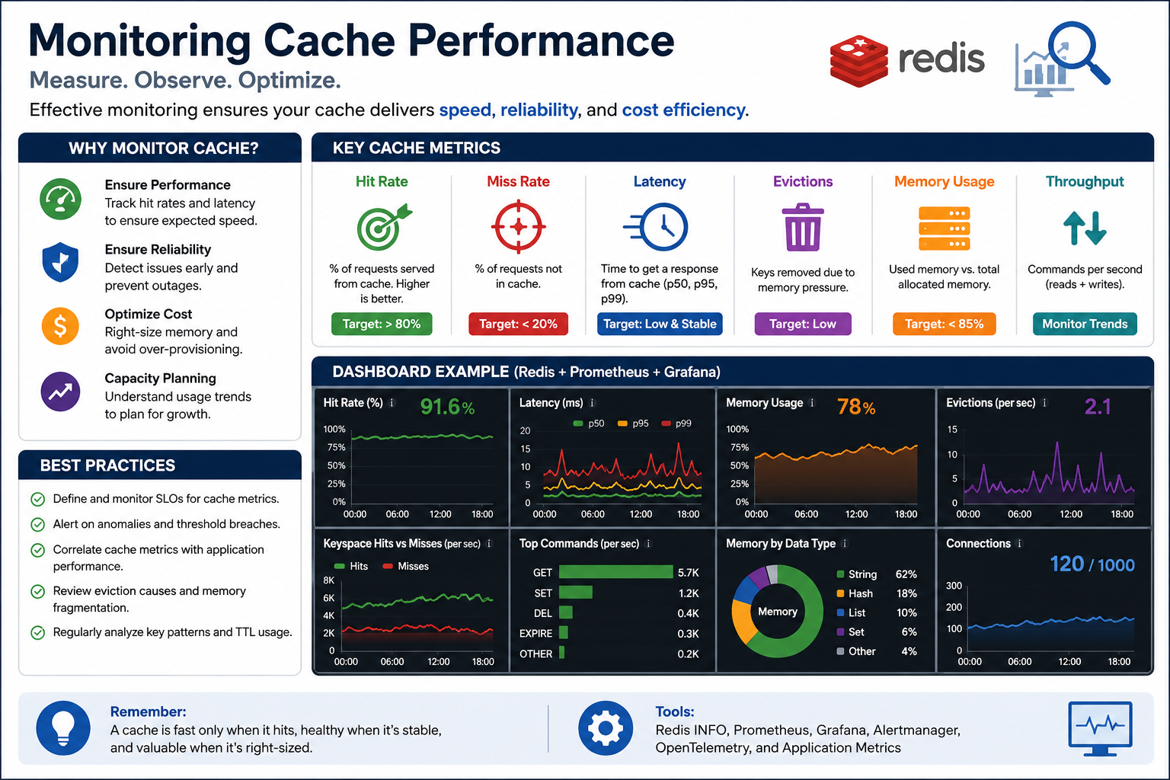
34
© 2026 by Innovation In Software Corporation
Notes:
KEY TALKING POINTS
------------------
- WHAT TO MONITOR
Hit rate tells you whether the cache is doing its job.
A low hit rate means keys are poorly chosen, TTLs are too short, or the data should not be cached.
Latency improvement compares cached reads with direct database reads.
A cache that adds a network hop for little gain is pure cost.
Memory usage and eviction rate show whether the cache is undersized.
Frequent evictions under memory pressure lower the hit rate and cause database spikes.
In Spring Boot, Micrometer publishes cache metrics through Actuator, the built-in metrics and health endpoints.
Redis caches also need spring.cache.redis.enable-statistics set to true.
- Key Cache Metrics
The top band shows six metrics.
They are hit rate, miss rate, latency at p50, p95, and p99, evictions, memory usage, and throughput.
The badges print targets, such as above 80 percent hit rate or below 85 percent memory.
These are illustrative rules of thumb, not course or bank standards.
Real targets come from the service's SLOs, its service level objectives, and from the business value of the cached data.
- Dashboard Example
The dark centre panel is a sample dashboard with made-up values.
It shows hit rate, latency percentiles, memory, evictions per second, hits versus misses, top commands, memory by data type, and connections.
Use it to show what good looks like.
That means a steady hit rate, flat latency, and memory with headroom.
Evictions should be low and explainable.
The spike pattern in the evictions chart is exactly what should trigger investigation.
- Best Practices and Tools
The left panel recommends several practices.
Set SLOs for cache metrics and alert on anomalies.
Correlate cache metrics with application performance.
Review eviction causes and fragmentation.
Analyse key patterns and TTL usage.
The footer tools are Redis INFO, Prometheus, Grafana, Alertmanager, OpenTelemetry, and application metrics.
In this course, Micrometer, Actuator, and OpenTelemetry are the observability stack.
So cache metrics belong on the same dashboards as the service's own metrics.
REAL-WORLD EXAMPLES
-------------------
- A team adds a cache to a slow account-summary endpoint.
Monitoring shows a low hit rate, because the key includes a timestamp that changes on every request.
Fixing the key design raises the hit rate and actually removes database load.
- An operations team sees evictions climb every afternoon during a bank's peak online banking hours.
They link it to memory reaching the configured limit.
They resize the cache before customers notice slower pages.
USE-CASE SCENARIO
-----------------
Suppose after the course the team caches supported-currency and merchant reference data in Risk Assessment Service.
They expose cache metrics through Actuator and chart them in Grafana next to scoring latency.
After a week, the hit rate is very high and scoring p95 has dropped, so the cache stays.
A second cache on per-transaction lookups shows a very low hit rate.
Every transaction ID is unique, and memory climbs steadily.
The data says remove it.
That is the slide's subtitle in practice: revisit the strategy instead of leaving it running.

Slide 36
EXERCISE 2.1 — MAP DATA OWNERSHIP FOR ACCOUNT VS TRANSACTION
Module 4 checkpoint A — Separate DBs/schemas; no cross-service tables.
🎯
OBJECTIVE
📝
DO THIS
✅
EXPECTED RESULT
• Separate DBs/schemas; no cross-service tables
• 10 min · design checkpoint
• Worksheet: curriculum/day-02/exercises/exercise-2.1-data-ownership.md
1. Account table lives only in account_db. Transaction table lives only in transaction_db
2. Transaction stores accountId as a reference, not a foreign key across services
3. Eligibility is a REST GET to Account Service, not a SQL join
4. Redis is lecture-only — not part of this capstone
• A two-column ownership map with zero shared tables.
• Lab 2 uses transaction_db on host port 5434. Never join to account_db.
KEY TAKEAWAY A two-column ownership map with zero shared tables.
35
© 2026 by Innovation In Software Corporation
Notes:
KEY TALKING POINTS
------------------
- OBJECTIVE
The goal is to separate databases or schemas so no table is shared across services.
It is a ten-minute design checkpoint on paper, not coding.
The worksheet is curriculum/day-02/exercises/exercise-2.1-data-ownership.md.
Participants should finish able to answer two things for every table and column in a transaction.
Which service owns it?
And how does the other service learn about it?
This comes last before Module 5, because the integration choices there only make sense once ownership is fixed.
- DO THIS
The accounts table from Lab 1 lives only in account_db on host port 5433, owned by Account Service on port 8081.
The transactions and processed_events tables live only in transaction_db on port 5434, owned by Transaction Service on port 8082.
Transaction stores account_id as a plain value with an index.
It never uses a foreign key into another database.
Eligibility is a REST call, GET /api/v1/accounts/{accountId}, and only ACTIVE accounts may transact.
Redis is lecture-only and must not appear in the design.
- EXPECTED RESULT
A good map has two columns.
One is headed Account Service with account_db, and the other Transaction Service with transaction_db.
The Account column lists the accounts table with account_id, customer_id, account_type, status, currency, nickname, and timestamps.
The Transaction column lists the transactions table, with account_id marked as a reference, plus processed_events.
Arrows between the columns are labelled REST GET for eligibility and later Kafka event.
They are never labelled SQL join or shared table.
Nothing appears in both columns except the account ID value.
REAL-WORLD EXAMPLES
-------------------
- Banks separating a card platform from a core deposit system often find reports that join card and deposit tables directly.
Mapping ownership first shows which of those joins must become API calls, events, or a reporting read model.
- Say a payments team needs to know whether an account is open.
The ownership map makes clear that it asks the account system through its API instead of querying the account table.
Then the account team can change its schema freely.
USE-CASE SCENARIO
-----------------
Run it this way.
Put people in pairs or threes and spend one minute on the brief.
Give six minutes to draw the map on the worksheet or a whiteboard.
Then take three minutes for debrief.
Circulate and look for the common mistakes.
One is a foreign key from transactions to accounts.
Another is a status column copied into transactions as the source of truth.
A third is a proposed shared schema for convenience.
In debrief, pick one strong map and ask three questions.
What happens when Account Service is down?
Lab 2 returns 503 ACCOUNT_SERVICE_UNAVAILABLE.
What if the account is frozen?
409 ACCOUNT_NOT_ELIGIBLE, no row, no event.
Where would Risk Assessment's data live in Lab 5?
In its own store.

